Slide 1

What's New With Journal Subscriptions and Open Access Fee Waivers:
2026 Edition!
Rebecca Bealer
Head, Serials/Systems Librarian
rbeale@lsuhsc.edu

Slide 2

This session will be recorded!
The link to the session and the PowerPoint presentation will be available at
https://www.lsuhsc.edu/library/services/classes.aspx

Slide 3
We subscribe to many, many journals!
Academy of General Dentistry
Academy of Operative Dentistry
Allen Press Incorporated
American Academy of Family Physicians
American Academy of Pediatric Dentistry
American Academy of Pediatrics
American Association for Cancer Research
American Association for Respiratory Care
American Association for the Advancement of Science
American Association of Critical Care Nurses
American Association of Immunologists
American Association of Neurological Surgeons
American Chemical Society
American College of Physicians
American Dental Hygienists' Association
American Diabetes Association
American Heart Association
American Institute of Physics
American Medical Association
American Occupational Therapy Association
American Physiological Society
American Podiatric Medical Association
American Psychiatric Association
American Psychological Association
American Public Health Association
American Roentgen Ray Society
American Society for Biochemistry and Molecular Biology
American Society for Cell Biology
American Society for Clinical Investigation
American Society for Microbiology
American Society for Pharmacology and Experimental Therapeutics
American Society of Allied Health Professionals
American Society of Clinical Oncology
American Society of Dentistry for Children
American Society of Hematology
American Society of Neuroradiology
American Speech Language and Hearing Association
American Thoracic Society
American Urological Association
Bioscientifica Limited
BMJ Journals
Cambridge University Press
Chronicle of Higher Education
Cell Press
Cold Spring Harbor Laboratory
Company of Biologists
DeGruyter
Elsevier Science Limited
European Respiratory Society Journals Ltd.
International Institute of Anticancer Research
John Wiley & Sons Incorporated
Journal of Bone and Joint Surgery
Journal of Orthopaedic & Sports Physical Therapy Incorporated
Journal of Rheumatology
JoVE
Lippincott Williams and Wilkins
Magna Publications
Mary Ann Liebert Incorporated
Massachusetts Medical Society
National Academy of Sciences
Nature Publishing Group
Oxford University Press
Portland Press Limited
Project HOPE
Quintessence
Radiological Society of North America
Rockefeller University Press
Royal Society
Rutgers University
Sage Publications
Sheridan Press
Slack Incorporated
Society for General Microbiology
Society for Neuroscience
Society of Nuclear Medicine
Springer Publishing
Springer-Verlag
Taylor & Francis
Thieme Medical Publishers Incorporated
University of Chicago Press

Slide 4
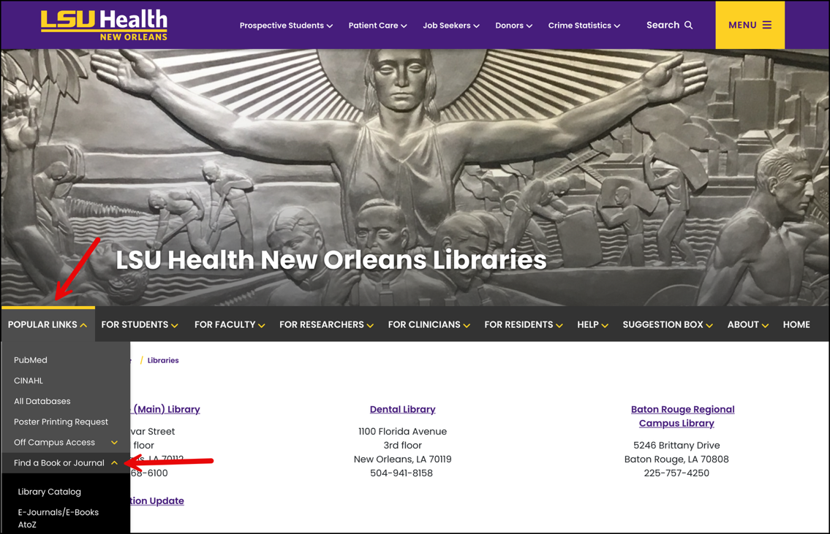
Getting to our journals, and other resources too!
Start at the Library’s webpage https://www.lsuhsc.edu/library

Slide 5
Start of a new subscription year
The bulk of our journal subscriptions run from January 1st through December 31st
Titles moving publishers: 41 at last count
Additions and removals from journal packages

Slide 6



Journal Highlights for 2026!

Slide 7
Bad News First: Cancellations
Low/no use
Annual Reviews
Diabetologia
Journal of Law, Medicine, and Ethics
Uncooperative publishers
Journal of the American Association for Laboratory Animal Science
Diabetes Spectrum

Slide 8
Titles ceasing publication
EcoSal Plus (American Society for Microbiology)
Emerging Topics in Life Sciences (Biochemical Society)
Hospital Practice (Taylor and Francis)
Journal of the Royal College of Physicians of Edinburgh (Sage)

Slide 9


One odd situation
American Journal of Public Health
No longer offer online-only subscriptions for institutions
Our access is now through CINAHL Ultimate and Academic Search Complete

Slide 10
Now for the good news!

Slide 11

Oxford University Press
Subscribe to All Journals Collection
12 transferred titles
  American Thoracic Society
  Society for Research in Child Development
  Academic Medicine
  European Journal of Heart Failure
  Journal of Veterinary Internal Medicine
  Reproduction
2 new titles
  Journal of Nephrology
  Molecular Omics

Slide 12
BMJ
Change in publisher’s offerings
  Now have access to all subscribed journals
  Will get new titles automatically as they are added
8 brand new titles
  BMJ Military Health
  BMJ Supportive and Palliative Care
1 title held previously (Regional Anesthesia and Pain Medicine)
At least 3 new journals by the end of the year

Slide 13
Sage Premier Collection
Started with 1,135 journals from 2025
Adding 18 titles during 2026
  Acupuncture and Electro-Therapeutics Research
  Education and Training in Autism and Developmental Disabilities (and 2 previous titles)
  Journal of Analytical Psychology

Slide 14
Taylor and Francis Medical Library
All journals from the American Association on Intellectual and Developmental Disabilities
American Journal on Intellectual and Developmental Disabilities
Intellectual and Developmental Disabilities
Inclusion (new!)

Slide 15
Wiley Database Model
Access to all subscription-based journals
Carrying over access to 1,515 journals
8 new titles
  Journal of the Royal Society of New Zealand
  (It’s a bit of a down year for this package)

Slide 16
ScienceDirect Freedom Collection
Package in addition to 413 direct subscriptions
2,342 titles from 2025
Adding 10 new titles
  Research in Neurodiversity
  More could be added during year

Slide 17
American Chemical Society (ACS)
Subscribe to all journals package
70 titles carried over
3 new titles
  ACS Nano Medicine
  ACS Nutrition Science
  Environmental Health Perspectives

Slide 18
JoVE (Journal of Visualized Experiments)
Maintaining subscription to JoVE Research
  JoVE Journals
  JoVE Research Encyclopedia of Experiments
One-year trial of Education modules
  Advanced Biology Series
  Basic Biology Series
  Clinical Skills Series
  Core Anatomy and Physiology
  Core Biology
  Core Medical-Surgical Nursing
  Core Nursing
  Core Pharmacology

Slide 19
New titles added throughout the year
ClinicalKey
Lippincott Williams and Wilkins Total Access Collection

Slide 20

Open Access and
Fee Waiver Agreements!

Slide 21
Types of agreements
Membership
  Library pays for journal
  Fees waived for publishing
Read and Publish
  Library pays to maintain access to journal content
  Library may have to pay extra for fee waivers to be available
Subscribe to Open
  Publisher sets threshold to make publication(s) open access for all
  Since the Library subscribes to the journal(s), often no limit to articles where fee is waived, but author will be responsible for any added fees (e.g. per page fees)

Slide 22
Notes for all fee waiver agreements
Corresponding author must be from LSUHSC-NO
Use your lsuhsc.edu email during submission process
Guidelines and information can be found at https://lsuh.sc/liboa
Waivers apply only to articles accepted for publication and only for eligible journals

Slide 23
Annual Reviews no longer available
Subscribe to open agreement
We cancelled our subscription to all Annual Reviews titles, and we are no longer eligible for any fee waivers

Slide 24
Membership
BMJ Case Reports
Contact us for code needed when submitting for publication

Slide 25
Read and Publish agreements
ScienceDirect
American Chemical Society
Radiological Society of North America

Slide 26
ScienceDirect
Library is paying a fee in addition to subscription costs
Fully open access journals not eligible, including ones that were previously subscription and are now open access
Not all Library-subscribed journals are eligible (Lancet, Cell Press, Clinics of North America, etc.)
All fees waived
Annual limit to number of waivers available

Slide 27
American Chemical Society
Library is paying in addition to subscription costs
Agreement covers both subscription and fully open access journals
All fees waived
No limit to number of waivers available

Slide 28
Radiological Society of North America (RSNA)
Included with cost of subscriptions, although this is the second of the two-year agreement for no additional cost
All fees waived
No limit to number of waivers available

Slide 29
Subscribe to Open agreements
Active by virtue of our subscribing to journals from these publishers
The article publishing charge (APC) is waived
Most do have additional fees the author would be responsible for (per page fees, processing charges, etc.)

Slide 30
Subscribe to Open eligible publishers
American Society for Microbiology
American Physiological Society
Biochemical Society
The Royal Society*

Slide 31
Questions?
Thank you!
Survey link: Presentation Feedback Form
More info: https://www.lsuhsc.edu/library
Fee Waiver info: https://lsuh.sc/liboa
Rebecca Bealer, rbeale@lsuhsc.edu

