Slide 1

The Evidence Review Accelerator: TERA Tools
Matt Folse, MLIS (He/They)
Scholarly Communications Librarian

Slide 2

Objectives
  What is The Evidence Review Accelerator?
  A brief review the toolset’s history
  Is it free?
  Live Demo

Slide 3
What is TERA?
  TERA Tools is a browser-based research platform
  A suite of tools for the research community to produce high quality, evidence-based research
    primarily in healthcare
  Peer-reviewed studies prove the tools allow researchers to perform systematic reviews faster and more rigorously while reducing errors
  Can assist searching, deduplication, screening, and more!
  By reviewers for reviewers

Slide 4
A Brief history of the Accelerator
  The original Systematic Review Accelerator (SRA) was released in 2017
  Created by Bond University’s (AU) Institute for Evidence-Based Healthcare
  The tools came first, but were developed by the IEBH Team for the 2-Week Systematic Review methodology published in 2019
  Since the number of tools has grown, as well as the number of partner institutions

Slide 5
Is it free?
Free Version
  Access to all tools
  Collaborate on unlimited projects
  Can only create one project
  Can screen up to 1,000 records per month
Paid Version
  Access to all tools
  Collaborate on unlimited projects
  Create (be the ‘owner’) of unlimited projects and all their associated data
  Can screen up to 10,000 records per month

Slide 6
LIVE DEMO

Slide 7
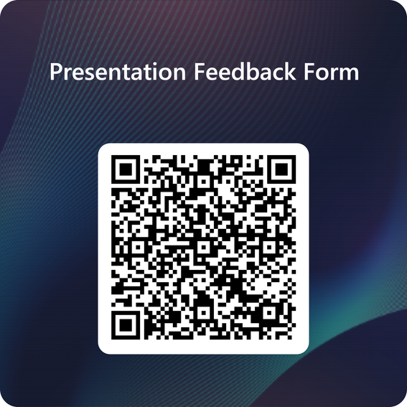

Outro Slide
Libraries’ contact:
reference@lsuhsc.edu
or call 504-568-6100
Contact me @:
mfols3@lsuhsc.edu
Thank you!

