Slide 1

Systematic and Scoping Reviews:
What They Are, Why They Matter, and How to Do Them Right
Sharon Duffy, MLIS
Research Services Librarian
School of Medicine Liaison
sduffy@lsuhsc.edu
Rowan Marye, MLIS
Public Services Librarian
School of Nursing Liaison
rmarye@lsuhsc.edu
November 2025

Slide 2
Objectives
What is a Systematic Review?
  Definition and sample questions
  Role in Evidence Based Medicine
  Rigor of Systematic Reviews
What is a Scoping Review?
  Compare and contrast to Systematic Reviews
Other Review Types – Rapid, Umbrella, Living
PRISMA – Reporting a Systematic Review
Process of Conducting a Systematic Review
  Detail the six steps in process
  Beyond the PICO question
Library resources to support your review

Slide 3
What is a Systematic Review?
“A study in which bias has been reduced by the systematic identification, appraisal, synthesis, and, if relevant, statistical aggregation of all relevant studies on a specific topic according to a predetermined and explicit method.” (Moher, 1999)
Intervention/Treatment question:
What is the effectiveness, tolerability, and safety of using electronic cigarettes to help people who smoke tobacco achieve long-term smoking abstinence?
What is the effectiveness of telehealth interventions compared to in-person care for managing chronic heart failure in adults?

Slide 4
Systematic Review Questions
Systematic reviews are ideal for questions that:
  Address a focused clinical or health-related issue
  Require synthesis of multiple studies to determine overall evidence
  Can be framed using PICO (Population, Intervention, Comparison, Outcome)
A Systematic Review is a “Study of Studies.”

Slide 5
Role in Evidence-Based medicine
Systematic Reviews play a central role in EBM by:
Providing comprehensive and unbiased summary of best available evidence
Clarifying what is known and not known about potential benefits and harms of drugs, devices, etc.
Saving practitioners time and effort by providing reliable summaries
Informing clinical practice and policy

Slide 6
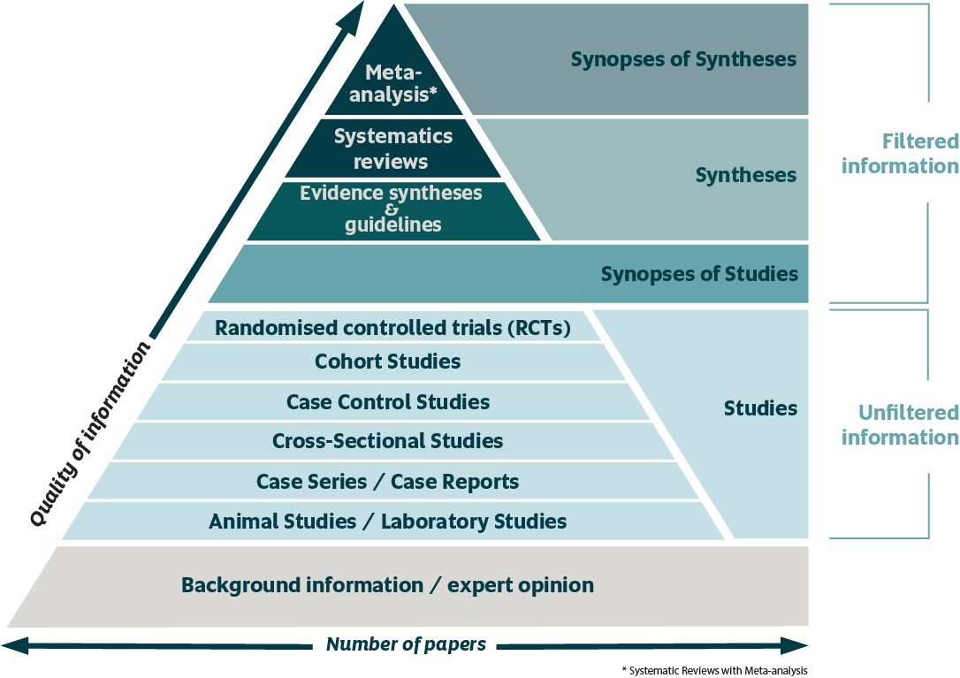
Evidence Pyramid
This Photo by Unknown Author is licensed under CC BY-SA-NC

Slide 7
Putting the “Systematic” into Systematic Reviews
Searching the literature
Evaluating the studies

Slide 8
Robust Methods lead to Robust evidence
Authors: 3 or more
Study Protocol: published in advance
Research Question: specific
Search Strategy: comprehensive and documented; garbage in = garbage out
Study Selection Criteria: Specified in advance
Critical Appraisal: Bias and quality
Synthesis: Qualitative or Quantitative

Slide 9
In short….
A systematic review must:
Address a clearly defined question
Make an effort to identify all relevant literature
A systematic review is characterized by its:
Formality
Transparency
Reproducibility
…it must be
SYSTEMATIC!

Slide 10
Questions?

Slide 11
What is a scoping Review?
A type of evidence synthesis that aims to map the existing literature on a broad topic or research area
Sample questions:
What types of interventions have been studied to improve medication adherence among patients with type 2 diabetes?
What models of nurse-led care have been applied in managing chronic diseases?
What approaches have been used to promote mental health in workplace settings?

Slide 12
scoping Review Questions
Scoping reviews are ideal for research when:
  The topic is complex or emerging and you want to understand the scope of research that exists. You want to “map the evidence.”
  You need to identify key concepts, gaps, and the types of evidence available
  You are not assessing the effectiveness of interventions but rather exploring what has been studied
  Can be used as a first project to structure other research endeavors
Goals: Map evidence, clarify concepts, identify gaps

Slide 13
Scoping vs. Systematic Review
Feature | Scoping Review | Systematic Review
Purpose | Map existing literature, identify gaps, clarify concepts | Answer a focused question and synthesize evidence
Research Question | Broad, exploratory | Narrow, specific (often PICO-based)
Study Inclusion | Wide range of sources (empirical, theoretical, gray literature) | Strict criteria, usually empirical studies
Critical Appraisal | Not typically performed | Always performed (risk of bias, methodological quality)
Outcome | Descriptive summary, themes, research gaps | Evidence synthesis, may include meta-analysis
Use Case | Early-stage research, topic mapping | Clinical decision-making, guideline development

Slide 14
Similarities Between Scoping and Systematic Reviews
Feature | Similarity
Structured Approach | Both follow systematic, transparent methods for searching and selecting studies
Protocol Use | Both often use predefined protocols
Bias Reduction | Both aim to minimize bias through comprehensive search strategies
Evidence Mapping | Both provide an organized synthesis of existing literature
Reproducibility | Both emphasize reproducibility and clear documentation
Value for Practice | Both inform evidence-based practice and policy decisions

Slide 15
Additional Review Types
Review Type | Purpose | Key Features | Typical Use Case
Rapid Reviews | Provide evidence quickly for urgent decisions | Streamlined methods, limited scope, fewer databases | Health policy or clinical decisions under time constraints
Umbrella Reviews | Summarize multiple systematic reviews on a broad topic | High-level synthesis, focuses on systematic reviews | When several systematic reviews exist on related interventions
Living Reviews | Continuously update evidence as new studies emerge | Dynamic updates, digital publication | Rapidly evolving fields like COVID-19 or emerging therapies

Slide 16
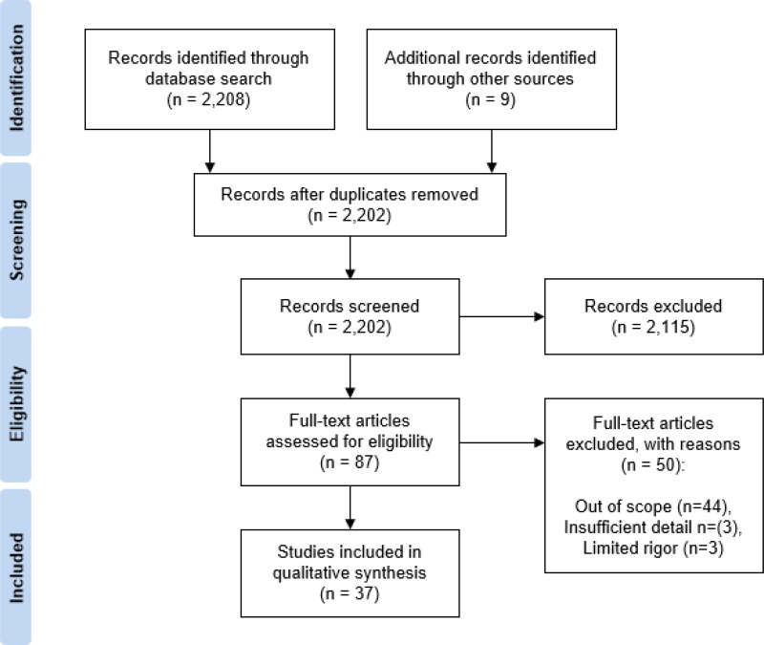
Reporting of systematic reviews
PRISMA 2020:
Preferred Reporting Items for Systematic reviews and Meta-Analyses
27 item checklist
Utilizes a flow diagram to show study selection process
PRISMA-ScR:
for Scoping Reviews
20 item checklist

Slide 17
Any Questions?

Slide 18
Systematic reviews: step-by-step
Phrase the research Question
Search for all the evidence
Select relevant studies
Extract data
Assess study quality
Data analysis

Slide 19

Step 1: ASK your research question

Slide 20
What makes a good research question?
F.I.N.E.R. Criteria
Feasible
Interesting
Novel
Ethical
Relevant
Willis L. D. (2023). Formulating the Research Question and Framing the Hypothesis. Respiratory care, 68(8), 1180–1185. https://doi.org/10.4187/respcare.10975

Slide 21
The anatomy of the question
Considering the structure of your question helps to articulate the scope of your review and determine inclusion/exclusion criteria.
Using a question framework can help you identify the different components of your topic and focus your research.

Slide 22
The pico framework
You’ve heard of this one. It is the most used framework for clinical questions.
What is the effectiveness, tolerability, and safety of using electronic cigarettes to help people who smoke tobacco achieve long-term smoking abstinence?
PICO is the standard framework for this type of question.
Population: tobacco smokers
Intervention: electronic cigarettes
Comparison/Control: not explicitly stated
Outcome: long term abstinence

Slide 23

The limitations of Pico
PICO is formulated specifically with clinical questions in mind. It may be less successful in articulating other types of questions.
It focuses on clinical questions that involve an intervention or therapy, as well as on experimental research.
If your question doesn’t fit into those categories, then PICO may be a poor fit for your question.

Slide 24
Some Other ways to ask
PICo
For qualitative questions
(Population, phenomena of Interest, COntext)
PEO
Focuses on non-numerical data or qualitative research
Population, Exposure, Outcome
Example: In infants between the age of 6 to 9 months (P), is there an association between exposure to micro-doses of common food allergens (E) and reduced childhood food allergies? (O)
https://scientific-publishing.webshop.elsevier.com/research-process/clinical-questions-pico-and-peo-research/#What_is_a_PEO_Question

Slide 25
Some Other ways to ask (cont)
CoCoPop
for prevalence or incidence questions
COndition, COntext, POPulation
Example: What is the prevalence of dementia (Condition) in rural areas (Context) of the United States (Population)?
SPIDER
For qualitative or mixed methods research topics focused on "samples" rather than populations.
Sample, Phenomenon of Interest, Design, Evaluation, and Research type.
Example: For first-time mothers (S), does antenatal education (PI) positively affect their delivery experience (E)? Design (D) = interviews/surveys, Research Type (R) = Qualitative
https://library.aah.org/guides/literaturesearching/spider

Slide 26
Some Other ways to ask (continued)
CLIP/ECLIPSE
Useful for qualitative research topics investigating the outcomes of a policy or service.
Expectation, Client group, Location, Impact, Professionals, and SErvice.
SPICE
For qualitative research topics evaluating the outcomes of a service, project, or intervention.
Setting, Perspective, Intervention/exposure/interest, Comparison, and Evaluation.
Example: For teenagers in South Carolina, what is the effect of provision of Quit Kits to support smoking cessation on number of successful attempts to give up smoking compared to no support ("cold turkey")?
https://guides.lib.unc.edu/pico/frameworks

Slide 27
Step 2: Search for all evidence
Recruit your friendly neighborhood librarian to your cause.

Slide 28
Select appropriate databases
Include both general medical databases:
PubMed
Embase
Google Scholar
And area-specific databases, like APA PSYCinfo or ERIC, when appropriate.

Slide 29
Building your search
Include synonyms, related terms, alternate spellings, and trade names.
Use Boolean operators to combine terms. Use “OR” to combine synonyms and “AND” to connect concepts.
Apply proximity indicators or wildcards according to the database’s rules.
Use Field Tags to narrow the scope of your search, as appropriate.
Make sure to translate you search from one database’s language to another’s.
(Sound overwhelming? That’s why you need a librarian on your team).

Slide 30
Step 3: select relevant studies
Inclusion and Exclusion criteria
Should be documented in your protocol
Aims to select only studies that address review question
Beware of exclusion criteria that perpetuate research bias, such as limiting to English language studies only
Plan for resolution of disputes on your review team

Slide 31
The selection process
Selection Steps
Collate all records retrieved by your search
Remove duplicates
Title and Abstract screening for potential inclusion
Full Text screening
Tools
Covidence
JBI Sumari
Citation manager, such as Refworks, Endnote, or Zotero
Good ol’ Excel

Slide 32
Step 4: extract data
Include
Methods (study design, duration, blinding)
Participants (numbers, setting, age, sex, etc)
Outcomes (definition, diagnostic method, etc)
Interventions (does, route of delivery)
Results

Slide 33
Step 5: assess study quality
(AKA critical appraisal)
Critical appraisal is the systematic evaluation of clinical research papers in order to establish:
Does this study address a clearly focused question?
Did the study use valid methods to address this question?
Are the valid results of this study important?
Are these valid, important results applicable to my patient or population?
From University of Oxford’s Centre for Evidence-Based Medicine: https://www.cebm.ox.ac.uk/resources/ebm-tools/critical-appraisal-tools

Slide 34
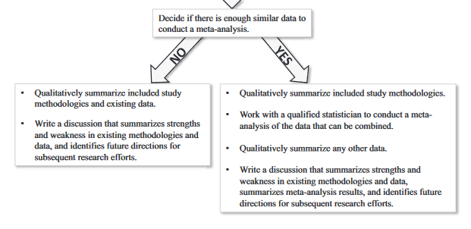
Step 6: analysis
Meta-analysis may not be possible if there is too much heterogeneity in the data.

Slide 35



Resources for Systematic Reviews
The Cochrane Collaboration is an independent global organization that collaborates to produce trusted synthesized evidence, make it accessible to all, and advocate for its use.
Their work is internationally recognized as the benchmark for high-quality information about the effectiveness of health care.
https://training.cochrane.org/
The Joanna Briggs Institute (JBI) is a global organization promoting and supporting evidence-based decisions that improve health and health service delivery.
Extensive training and education
JBI Sumari software
JBI EBP Database (via Wolters Kluwer)
PRISMA 2020 Website
Reporting guidelines for authors to transparently report their systematic review.
https://www.prisma-statement.org/

Slide 36
Library resources
Systematic Review Service
Literature searching
Create Covidence account
Expertise in review methodology
Write search methods portion of protocol/manuscript
Complete our Form to tell us about your project and get started
Systematic Review Service LibGuide

Slide 37




Connect with us!
Survey (Very short!)
Help us collect metrics!
Survey (Very short!)
Help us collect metrics!
Follow us on Instagram!
Sign up for Library Emails!
Sharon Duffy, MLIS
Research Services Librarian
School of Medicine Liaison
Data Services Librarian
sduffy@lsuhsc.edu
Rowan Marye, MLIS
Public Services Librarian
School of Nursing Liaison
rmarye@lsuhsc.edu

Slide 38
Bibliography
Bahadoran, Z., Mirmiran, P., Kashfi, K., & Ghasemi, A. (2020). Importance of Systematic Reviews and Meta-analyses of Animal Studies: Challenges for Animal-to-Human Translation. Journal of the American Association for Laboratory Animal Science : JAALAS, 59(5), 469–477. https://doi.org/10.30802/AALAS-JAALAS-19-000139
Higgins JPT, Thomas J, Chandler J, Cumpston M, Li T, Page MJ, Welch VA (editors). Cochrane Handbook for Systematic Reviews of Interventions version 6.4 (updated August 2023). Cochrane, 2023. Available from www.training.cochrane.org/handbook
Deeks JJ, Higgins JPT, Altman DG (editors). Chapter 10: Analysing data and undertaking meta-analyses. In: Higgins JPT, Thomas J, Chandler J, Cumpston M, Li T, Page MJ, Welch VA (editors). Cochrane Handbook for Systematic Reviews of Interventions version 6.4 (updated August 2023). Cochrane, 2023. Available from www.training.cochrane.org/handbook.
Ioannidis J. P. A. (2023). Systematic reviews for basic scientists: a different beast. Physiological reviews, 103(1), 1–5. https://doi.org/10.1152/physrev.00028.2022
Moher, D., Cook, D. J., Eastwood, S., Olkin, I., Rennie, D., & Stroup, D. F. (1999). Improving the quality of reports of meta- analyses of randomised controlled trials: the QUOROM statement. The Lancet, 354(9193), 1896-1900.
O’Hagan, E.C., Matalon, S., & Riesenberg, L. A. (2018). Systematic reviews of the literature: A better way of addressing basic science controversies. American Journal of Physiology-Lung Cellular and Molecular Physiology, 314(3), L439- L442. https://doi.org/10.1152/ajplung.00544.2017
Page MJ, McKenzie JE, Bossuyt PM, Boutron I, Hoffmann TC, Mulrow CD, Shamseer L, Tetzlaff JM, Akl EA, Brennan SE, Chou R, Glanville J, Grimshaw JM, Hróbjartsson A, Lalu MM, Li T, Loder EW, Mayo-Wilson E, McDonald S, McGuinness LA, Stewart LA, Thomas J, Tricco AC, Welch VA, Whiting P, Moher D. The PRISMA 2020 statement: an updated guideline for reporting systematic reviews. BMJ. 2021 Mar 29;372:n71. doi: 10.1136/bmj.n71. PMID: 33782057; PMCID: PMC8005924.

