Slide 1
Research Impact 102:
Building a Strong Scholarly Presence
Sharon Duffy
Research Services Librarian
School of Medicine Liaison
sduffy@lsuhsc.edu
Matthew Folse
Scholarly Communications Librarian
School of Public Health Liaison
mfols3@lsuhsc.edu
November 2026

Slide 2
Watch our Research Impact Series
Research Impact 101: Understanding and Calculating Your h-Index
Recording available on Library YouTube Channel
Slides available on LSU Health Digital Scholar

Slide 3
Today’s Outline
Review h-Index Metric Components
Moving from Metrics to Scholarly Identity
The Scholarly Identity Ecosystem
Importance of ORCiD
Challenges for Researchers
New Services from Libraries
  ORCiD ID Service
  Scholarly Profile Audit Service
Next Steps

Slide 4
Review Components of h-Index
Recall that the h-Index utilizes two factors:
1. Author publications
2. Number of citations each publication received
Metric is only as reliable as the scholarly record that it’s based on
Missing works Visibility not fully represented Author impact not correct

Slide 5
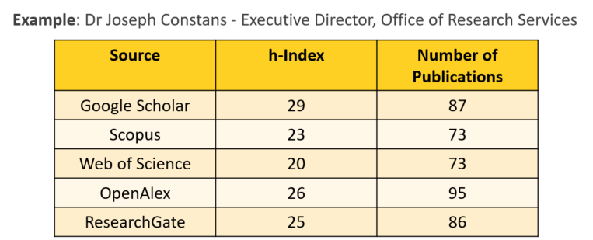

H-Index Variability
Also recall that the h-Index will vary in each platform due to the list of publications available:

Slide 6
From Metrics to Scholarly Identity:
The Scholarly Identity Ecosystem

Slide 7
The Scholarly Identity Ecosystem
ORCiD
Google Scholar
Scopus
Web of Science
OpenAlex
SciENcv
Data Repositories
eRA Commons
My NCBI account
Funders
Publishers

Slide 8
Role of ORCID iD
ORCID provides:
A unique 16-digit researcher identifier
Name disambiguation
Continuity across institutions and career changes
Integration with publishers and funders
Automatic updating opportunities through trusted connections
Serves as the “hub” of a scholarly identity
Library Information Session (May 2026) ORCID Made Easy
Session Recording
Slides
Bottom line:
ORCID plays a central role in the Scholarly Identity Ecosystem and keeping it current is an essential step.

Slide 9
Challenge for Researchers
Your scholarly presence exists across multiple interconnected platforms.
It is difficult to maintain updated scholarly profiles on all of them.

Slide 10
Common Problems Researchers Encounter
Publications missing from author profiles
Publications assigned to another researcher
Duplicate author profiles
Name variations
Profiles not connected to ORCID
Different publication counts between systems
Bottom Line:
If publications are missing, citation metrics such as the h-index may also be incomplete.

Slide 11
Demonstration

Slide 12
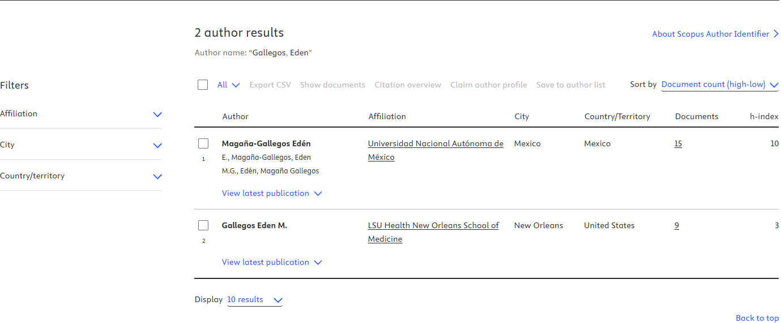
Common Problems: Similar Names
From: Scopus

Slide 13
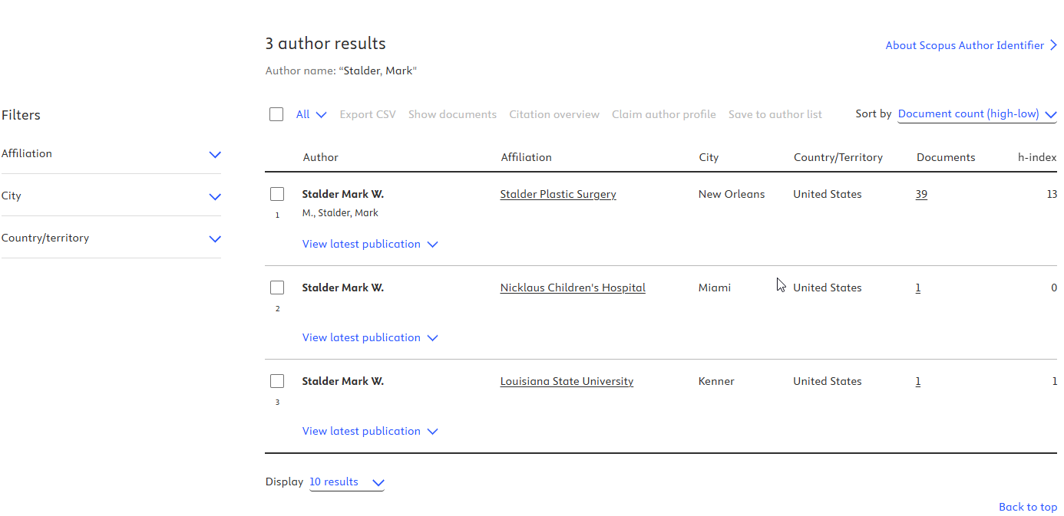
Common Problems: Duplicate Profiles – No ORCID
From: Scopus

Slide 14
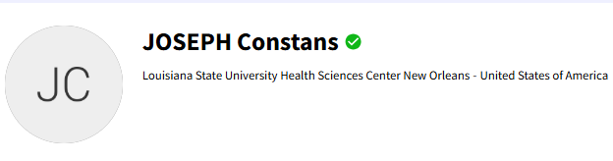
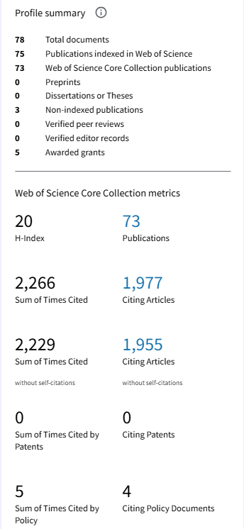
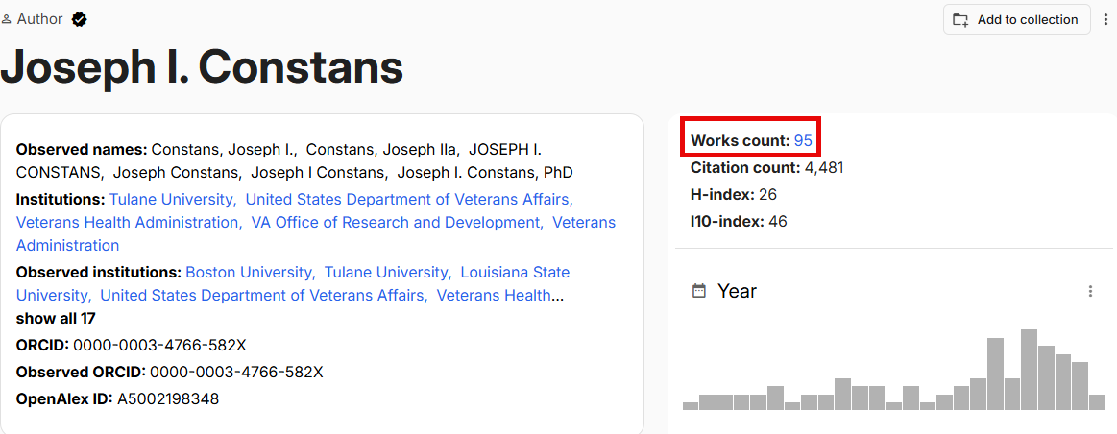
Common Problems: Work Counts
From: Web of Science
From: Open Alex

Slide 15
Solution from the Libraries
The Libraries now offer two new services to help researchers
maintain accurate scholarly profiles:
ORCID iD Service
Scholarly Profile Audit Service

Slide 16
ORCID iD Service
Creating an ORCID iD
Consolidating duplicate ORCID accounts
Adding publications and other scholarly outputs
Connecting trusted organizations for automatic updates
Reminder: ORCID is now required for federal grants
ORCID is the hub that connects your scholarly identity across systems.

Slide 17
Scholarly Profile Audit Process
Scholarly Profile Audit Process:
Fill out the Form (will show later)
Librarian(s) will acknowledge your request
Librarians will review your CV, ORCID, and Scholarly Profiles
Librarians will reach out for 1-on-1 to provide recommendations from audit
Only authors can make final changes to their Scholarly Profiles.

Slide 18
Scholarly Profile Audit Service
The Libraries will review profiles across platforms including:
Google Scholar
Scopus
Web of Science
OpenAlex
ResearchGate
Researchers will receive guidance regarding:
Missing publications
Duplicate profiles
Name ambiguity issues
Opportunities to link profiles
Overall profile completeness
Consider it a Scholarly Profile checkup.

Slide 19
Who Should Use These Services?
This service is valuable for everyone:
Early and mid career researchers
Established researchers with many publications
Students
Residents and fellows
Researchers preparing grant submissions
Faculty preparing promotion and tenure dossiers
Anyone who wants to verify their online scholarly presence
Bottom Line:
The Libraries can help researchers build, connect, and maintain a complete scholarly identity across the systems that generate visibility, metrics, and research impact.

Slide 20
Next Steps
Watch our Research Impact Series:
✅Research Impact 101: Understanding and Calculating Your h-Index
✅ Research Impact 102: Building a Strong Scholarly Presence
Ask yourself - How strong is my Scholarly Presence?
✔ Do you have an ORCID iD?
✔ Is it fully populated?
✔ Are all your publications connected across platforms?
✔ When was the last time you reviewed your author profiles?
Connect with the Libraries:
ORCID iD Service
Scholarly Profile Audit Service
Fill out the Form to get started:
Scholarly Profile Audit and ORCID iD Request Form

Slide 21
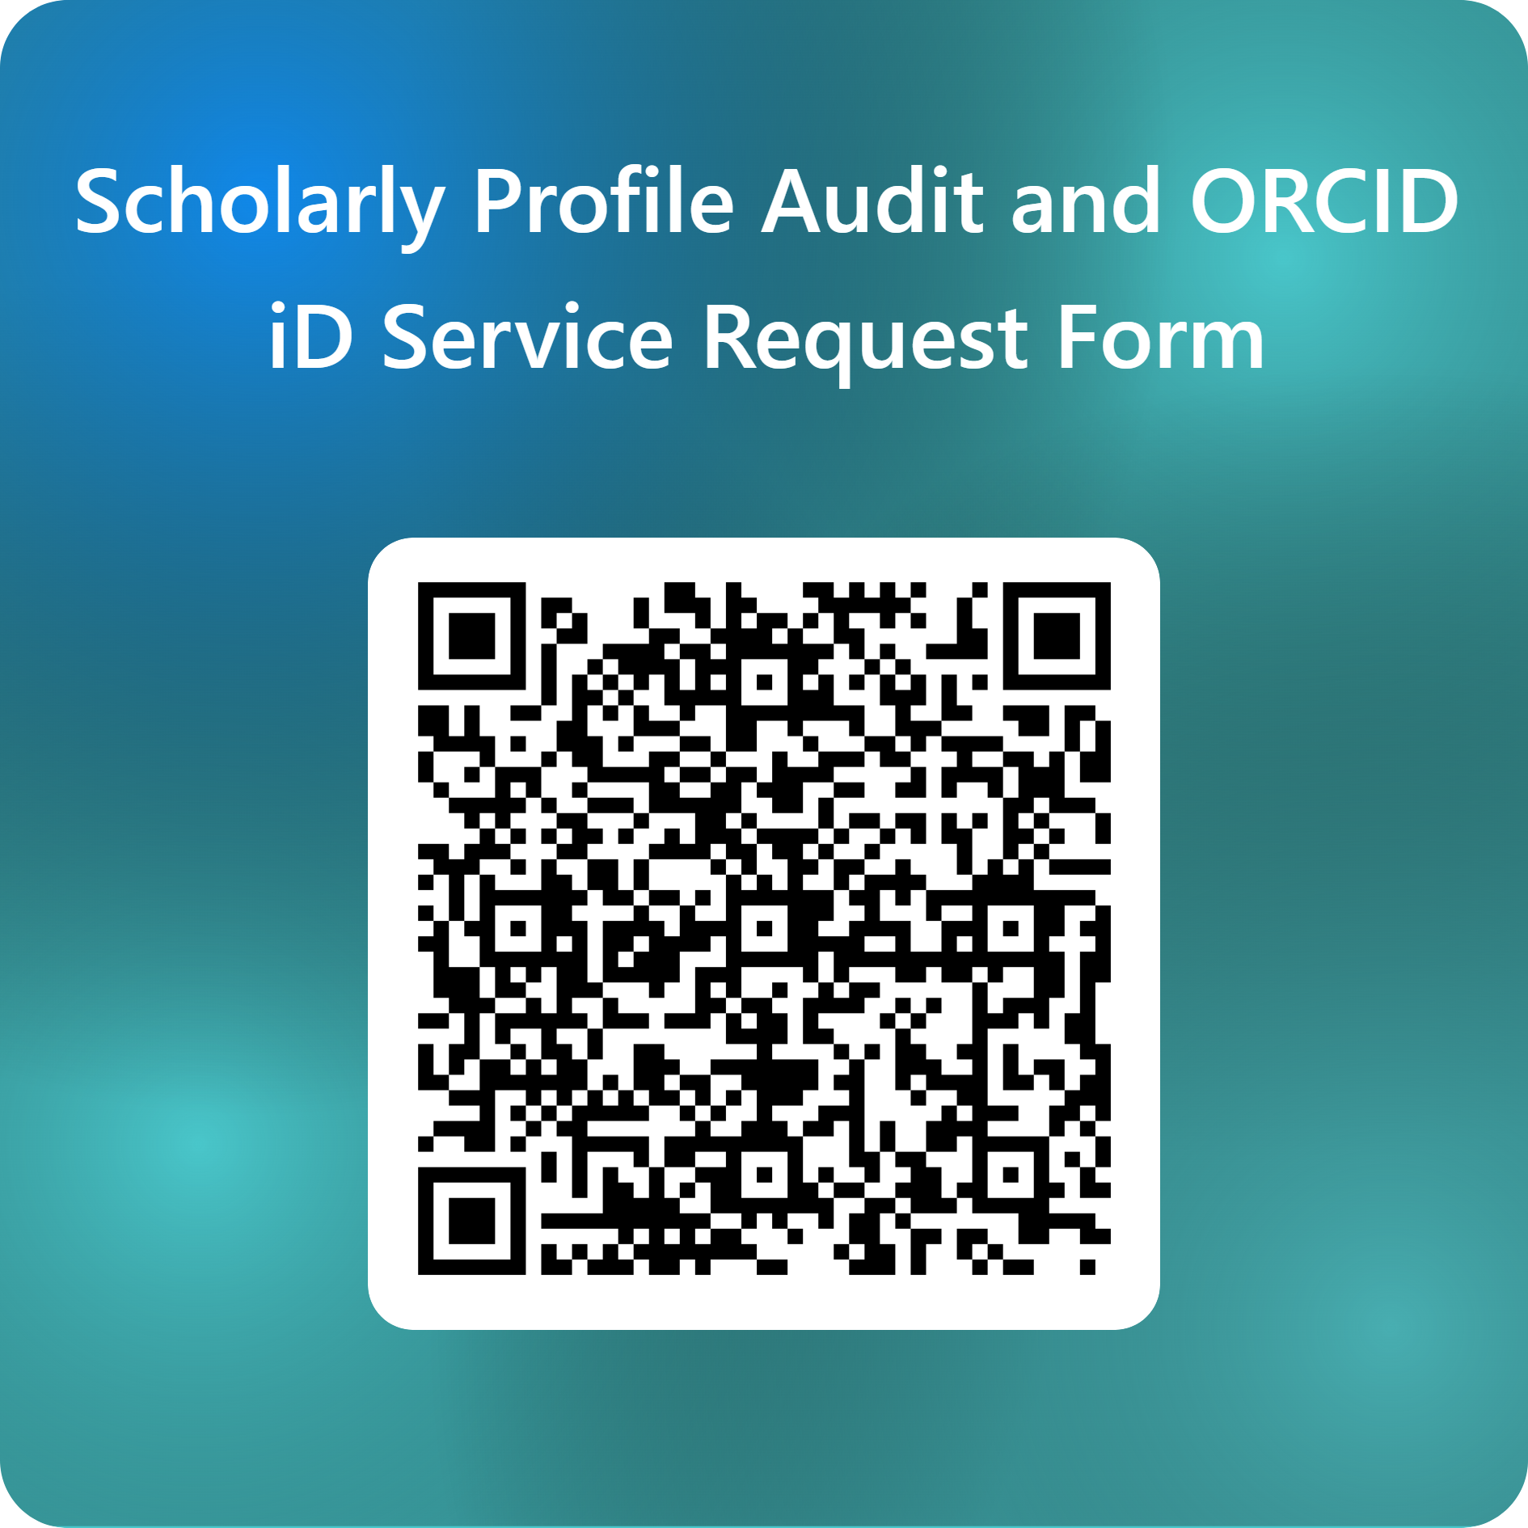

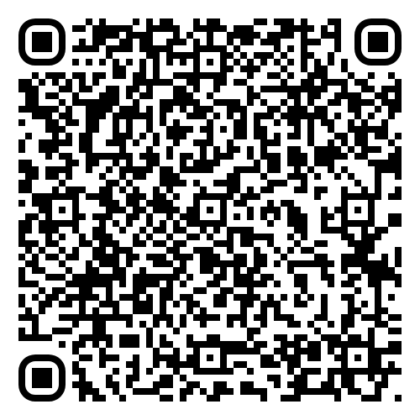

Any Questions?
Thank you for your attention!
Survey (Very short!)
Help us collect metrics!
Survey (Very short!)
Help us collect metrics!
Sign up for Library Emails!
Sharon Duffy
Research Services Librarian
School of Medicine Liaison
Data Services Librarian
sduffy@lsuhsc.edu
Matthew Folse
Scholarly Communications Librarian
School of Public Health Liaison
Data Services Librarian
mfols3@lsuhsc.edu

