Slide 1

Introduction to RefWorks
Chandler Smith, MA (he/him)
Education Librarian & allied health professions liaison

Slide 2
Objectives
How to access RefWorks and create an account
How to import citations from different databases
Creating a bibliography
Using RefWorks add-in in Microsoft Word/Google Docs

Slide 3
RefWorks
What is it?
A web-based software that allows you to organize your research, import references from databases, build a bibliography quickly, and share references with others
Databases have the ability to generate citations in various formats (APA, MLA, etc.) just double check them for accuracy!
https://libguides.lsuhsc.edu/citationmanagers

Slide 4
RefWorks and Other Citation Managers
Other popular citation management software:
EndNote – The Libraries also offer this citation manager!
Zotero

Slide 5

Accessing RefWorks
Access via Library’s website
Also available under popular links, at the bottom of the drop-down menu

Slide 6
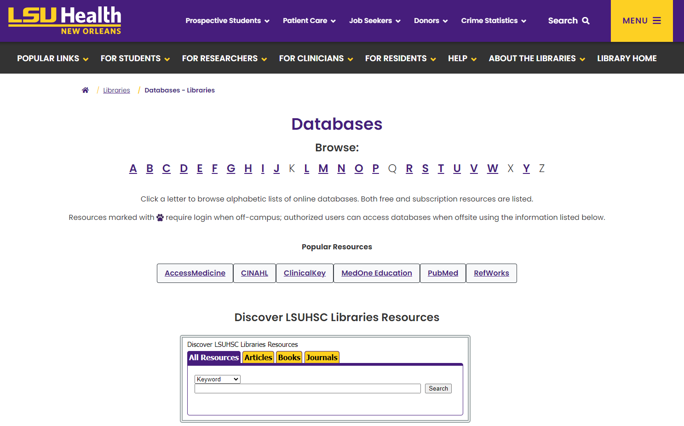
How to Access RefWorks
Available under “popular resources” or under “R” in the A-Z list

Slide 7
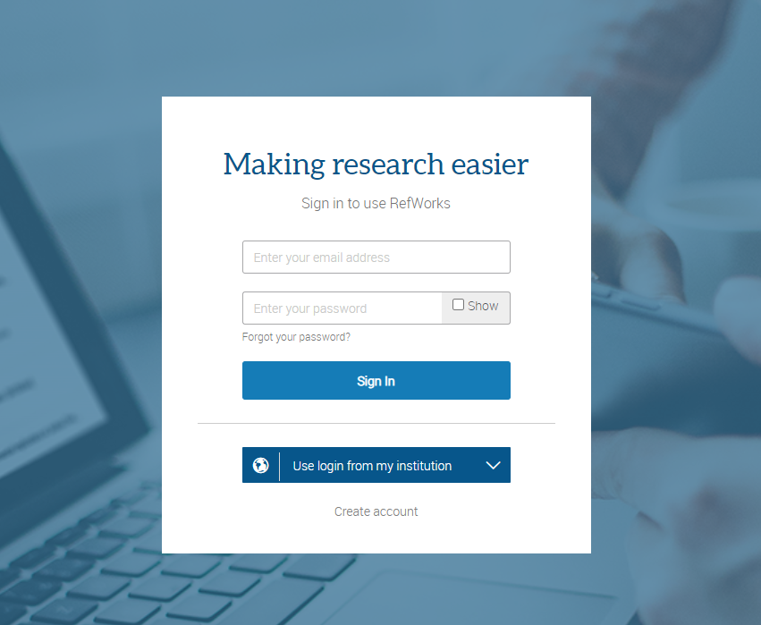
Logging Into RefWorks
Use your LSUHSC – New Orleans email!
If you use “log in from my institution” we are listed as Louisiana State University Health Sciences Center

Slide 8
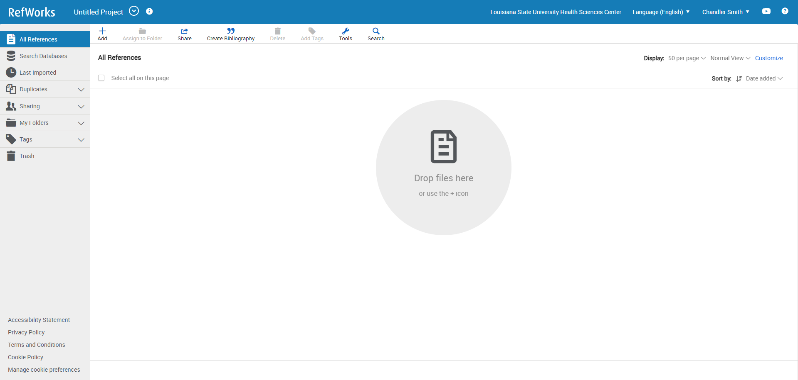
Logging Into RefWorks, continued

Slide 9
Importing Citations
PubMed
CINAHL (PsycInfo, SocIndex)
ProQuest Nursing and Allied Health
Embase

Slide 10
Live Demo
Showing how to import references from various databases
Find duplicates
Share folders/add collaborators
Create bibliography
Demonstrate Microsoft Word/Google Docs Add-In

Slide 11

Questions?

Slide 12
Contact info
Library Contact info:
Email: reference@lsuhsc.edu
Phone: 504-568-6100
Chandler Smith, Ma
Education Librarian
Allied Health Professions Liaison
csmi65@lsuhsc.edu

Slide 13


Survey

