Slide 1
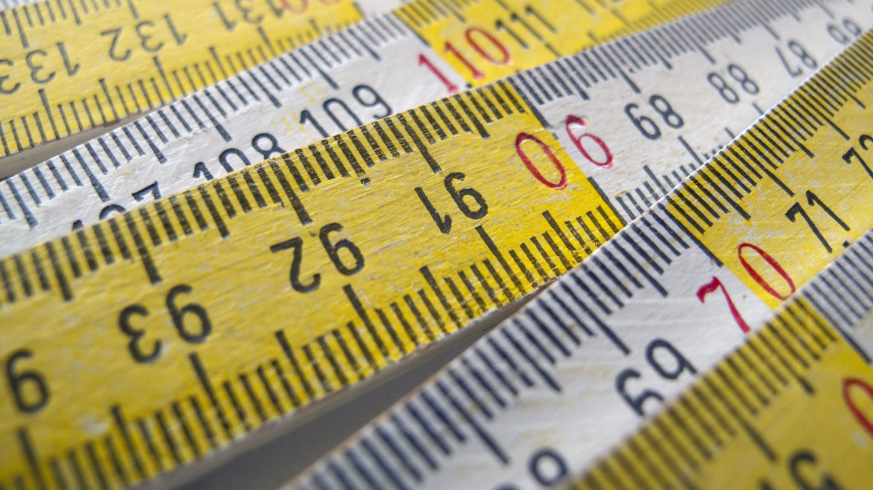
Measurements of
Health Literacy
Julie H. Schiavo EdD, MLIS, AHIP
Associate Librarian
Assistant Director, Dental Library
jschia@lsuhsc.edu
February 25, 2026

Slide 2
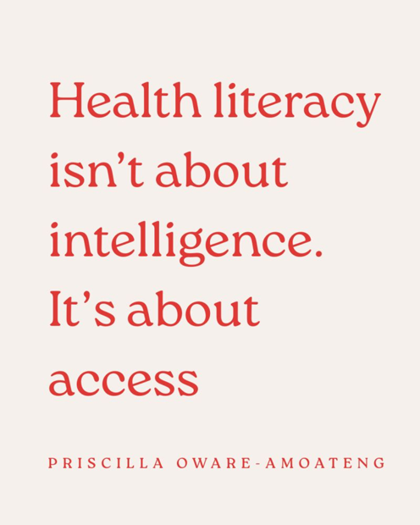
Health Literacy isn’t about intelligence
Notes:
Health Literacy Isn’t About Intelligence: It’s About Access:
We often assume that when a patient doesn’t understand, it’s because they can’t. But more often, it’s because they weren’t given fair access to understanding. Access to:
- Clear language
- Time to process
- A calm environment
- Culturally relevant explanations
- The freedom to ask questions without fear.
Health literacy isn’t fixed. It’s situational. A highly educated person can struggle to understand information when they are:
In pain
Anxious
Exhausted
Afraid
Overwhelmed by unfamiliar systems or language
And yet, when patients don’t follow instructions, the blame often lands on them. But here’s the uncomfortable truth:
If patients don’t understand, we have to question the access we provided — not their intelligence. Good healthcare communication doesn’t ask, “Did I explain it?”
It asks, “Did I create the conditions for understanding?”
Because access to understanding is a safety issue. And without it, even the best care plans can fail.

Slide 3
Types of Health Literacy
Personal health literacy - the degree to which individuals have the ability to find, understand and use information and services.
Organizational health literacy - the degree to which organizations equitably enable individuals to find, understand, and use information and services.
(Office of Disease Prevention and Health Prevention, n.d.)
Notes:
Healthy People 2030 distinguishes between personal health literacy (i.e., “the degree to which individuals have the ability to find, understand and use information and services” [Office of Disease Prevention and Health Promotion, n.d., para 3]) and
Organizational health literacy (i.e., “the degree to which organizations equitably enable individuals to find, understand, and use information and services” [para 4]),
both of which are explored in this presentation and present promising opportunities for librarian involvement.

Slide 4
Types of Health Literacy Measurement
Personal health literacy - the degree to which individuals have the ability to find, understand and use information and services.
Measurement: an individual’s comprehension, ability to understand, and ability to use written health information
Organizational health literacy - the degree to which organizations equitably enable individuals to find, understand, and use information and services.
Measurement: the readability of written materials
Notes:
Healthy People 2030 distinguishes between personal health literacy (i.e., “the degree to which individuals have the ability to find, understand and use information and services” [Office of Disease Prevention and Health Promotion, n.d., para 3]) and
Organizational health literacy (i.e., “the degree to which organizations equitably enable individuals to find, understand, and use information and services” [para 4]),
both of which are explored in this presentation and present promising opportunities for librarian involvement.

Slide 5

Personal Health Literacy

Slide 6
History of Literacy Assessments
1991 - First tool to measure health literacy specifically
More than 50 instruments in the published literature
Several of the measurements have additional versions (e.g., language, shortened, etc.)
Mancuso, J. M. (2009). Assessment and measurement of health literacy: An integrative review of the literature. Nursing and Health Sciences, 11(1), 77-89. http://doi.org/10.1111/j.1442-2018.2008.00408.x

Slide 7
Popular Health Literacy Assessments
REALM (Word recognition)
TOFHLA (Comprehension and numeracy)
NVS (Literacy and numeracy)
Performance-based Tools: Objective assessments requiring patients to perform tasks
BRIEF (Information seeking and Document)
SILS (Application and Comprehension)
Self-reported Tools: Subjective assessments relying on patients’ perceptions of their abilities and comfort

Slide 8
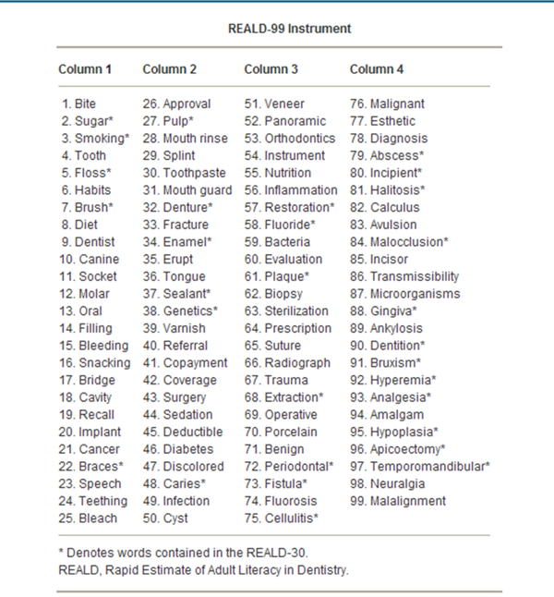
REALD-99
The participant is given this laminated card and asked to pronounce as many words as they can. The test is stopped when they begin to mispronounce the words.
Notes:
ENTER IN CHAT
Talking point: What problems would you see here?

Slide 9
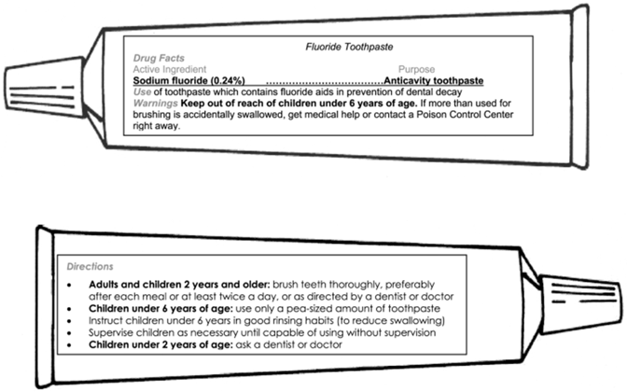
TOFHLiD
Respondents were asked:
The minimum number of times teeth should be brushed each day
If teeth should be brushed after breakfast
If a child 1 1/2 years of age should use this toothpaste
The amount of toothpaste that should be used if a child is less than 6 years of age.
Notes:
Respondents were asked:
The minimum number of times teeth should be brushed each day;
If teeth should be brushed after breakfast;
If a child 11/2 years of age should use this toothpaste; and
The amount of toothpaste that should be used if a child is less than 6 years of age.

Slide 10
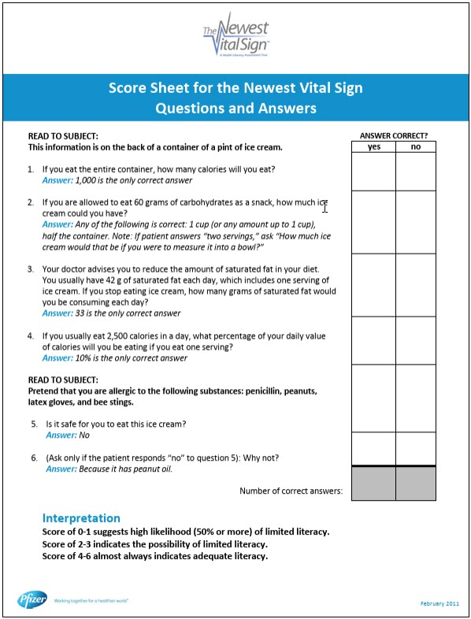
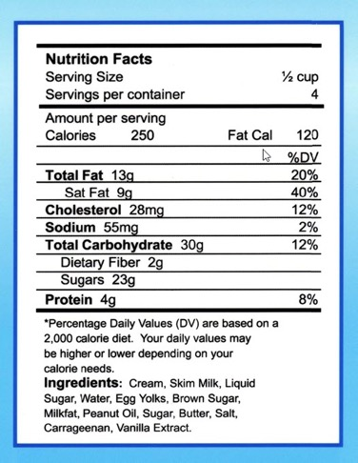
Newest Vital Sign

Slide 11
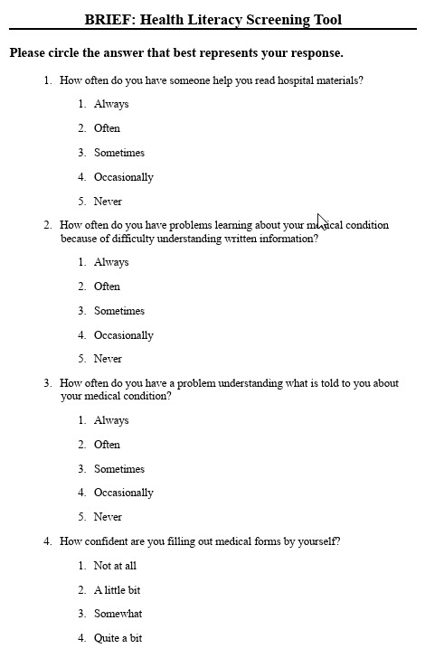
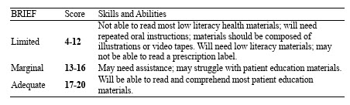
BRIEF: Health Literacy Screening Tool
Notes:
BRIEF (Brief Health Literacy Tool)
“How often do you have someone help you read hospital materials?”
“How confident are you filling out medical forms by yourself?”
“How often do you have problems learning about your medical condition because of difficulty understanding written information?”
“How often do you have a problem understanding what is told to you about your medical condition?”
SILS (Single Item Literacy Screener)
“How confident are you filling out medical forms by yourself?”

Slide 12
Is it a good idea to administer formal literacy assessments in clinical situations?

Slide 13
Formal literacy screening in clinical situations?
Is it a good idea to administer formal literacy assessments in clinical situations?
  Formal literacy screening in clinical situations could allow health professionals to tailor their communication to the needs of the patient.
  However, literacy assessments can be the source of shame and result in excess stress for the patient.
Current evidence does not support the use of formal literacy assessments in clinical practice. Instead, Universal Precautions recommend beginning every clinical encounter with the assumption that the patient will have trouble understanding.
Paasche-Orlow, M. K., & Wolf, M. S. (2008). Evidence does not support clinical screening of literacy. Journal of general internal medicine, 23(1), 100–102. https://doi.org/10.1007/s11606-007-0447-2
Health Literacy Universal Precautions Toolkit, 3rd Edition. Content last reviewed January 2025. Agency for Healthcare Research and Quality, Rockville, MD. https://www.ahrq.gov/health-literacy/improve/precautions/toolkit.html

Slide 14
Informal Health Literacy Assessments: Observe Behavior
Observe Patient Behavior
  Missing appointments / lack of follow-up
  Incomplete or inaccurate registration forms or medical history
  Avoidance of reading: “I forgot my glasses” / “I’ll read this when I get home” / “I’m too tired to read”
  Lack of interest, impatience, or hostility toward written materials
  Asking fewer questions
  Medication errors
  Identification of medication by looking at pills
  Eyes wander over the page
  Using their finger to help them read

Slide 15
Informal Health Literacy Assessments: Ask Questions
Ask questions
  Ask patients to read their prescription bottles and then explain how to take the medication
  How do you like to learn? Written? Conversation? Video? Something else?
  Consider asking the question from the SILS tool: “How confident are you filling out medical forms by yourself?”
  Teach-Back technique
    “Show me how so I know I explained it well”
    “What will you tell someone at home about today’s appointment?”

Slide 16

Organizational Health Literacy

Slide 17
History of Readability Measures
1920s - first text readability formulas
Flesch (1946) - argued for using word count, sentences, affixes, and personal references to assess written materials
Fry (1977) readability formula - number of sentences and syllables
Doak et al.’s (1996) - organization, writing style, appearance, and appeal

Slide 18
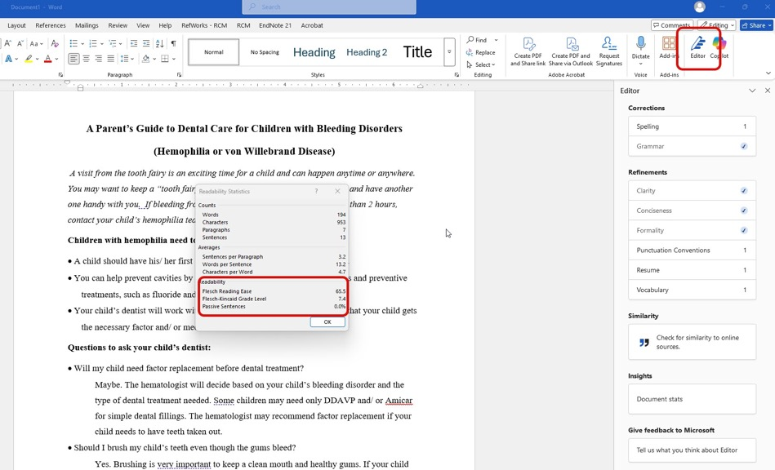
Built in Word Features

Slide 19
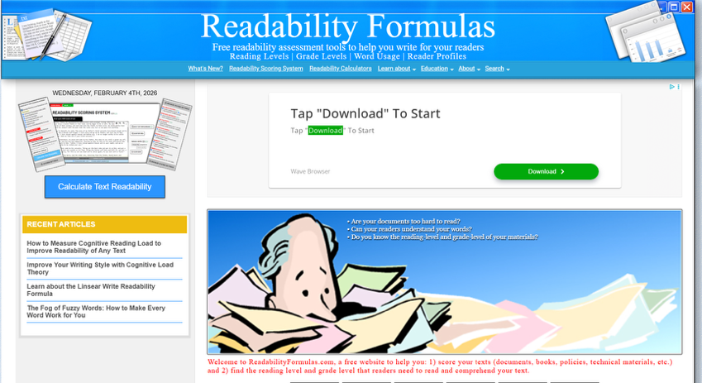
https://readabilityformulas.com/
Automatic Readability Checker
About Readability Formula that defines 18 of the most popular formulas/tests

Slide 20
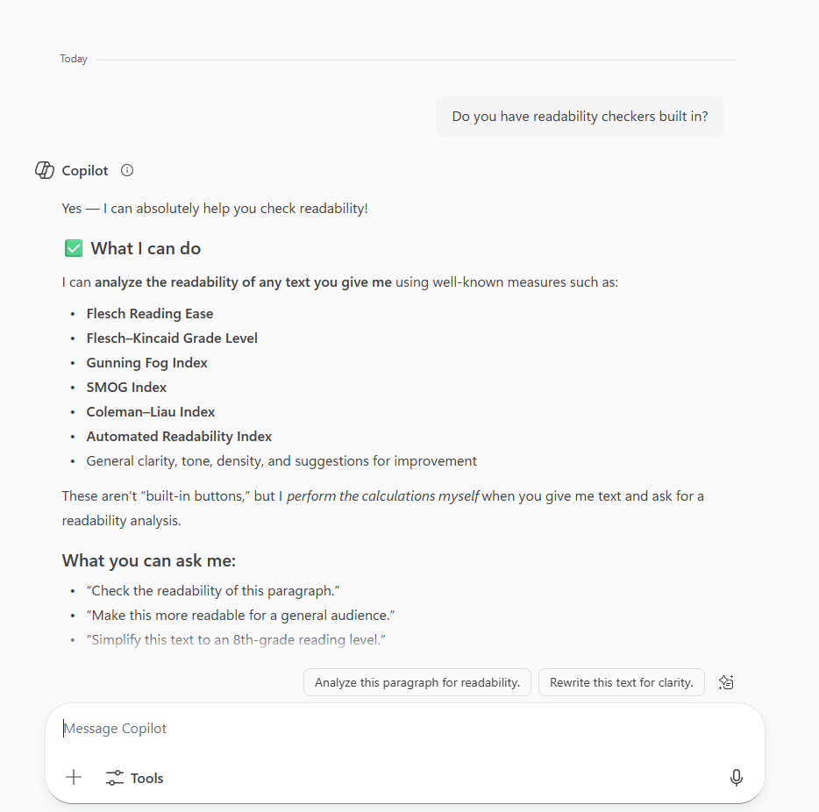
AI Tools

Slide 21
Use Tools with Caution
Hand-scoring (using the Simple Measure of Gobbledygook [SMOG]) produces a higher mean reading grade level than using computerized methods (e.g., with the Flesch-Kincaid test in Microsoft Word; Grabeel et al., 2018)
Computerized assessments may not be representative of the actual reading levels of patient education materials
Grabeel, K. L., Russomanno, J., Oelschlegel, S., Tester, E., & Heidel, R. E. (2018). Computerized versus hand-scored health literacy tools: A comparison of Simple Measure of Gobbledygook (SMOG) and Flesch-Kincaid in printed patient education materials. Journal of the Medical Library Association, 106(1), 38–45. http://doi.org/10.5195/jmla.2018.262

Slide 22
Things to keep in mind…
Print size
Type style
Color contrast
Concept density
Unfamiliar context
Many of these aspects are not as easy to assess using a standard readability formula and should be taken into consideration.

Slide 23

Resources and Tools

Slide 24
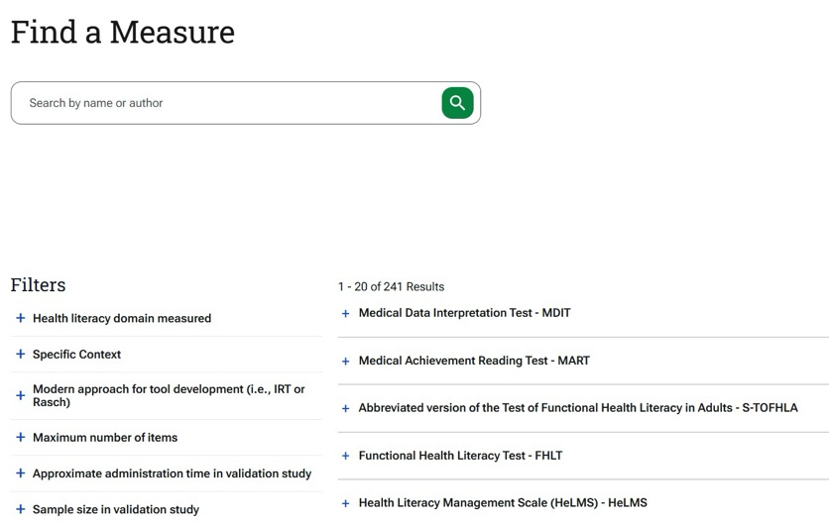
Health Literacy Tool Shed
Information about measures based on peer-reviewed literature.
Produced by Tufts Medicine
https://www.tuftsmedicine.org/research-clinical-trials/research-institutes-research-specialty/center-health-literacy-research-and-practice/health-literacy-tool-shed

Slide 25
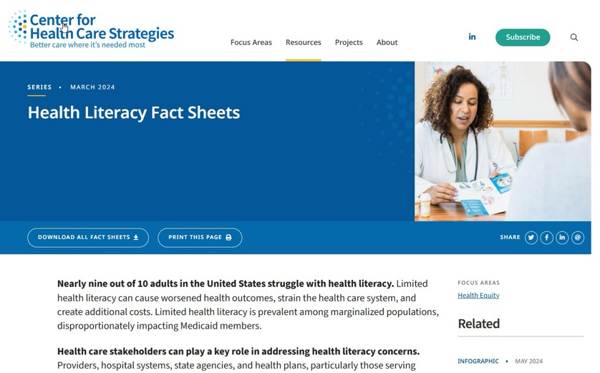
Health Literacy Fact Sheets
Center for Health Care Strategies
https://www.chcs.org/resource/health-literacy-fact-sheets/

Slide 26
LSUHSC-NO Libraries:
IRB, IACUC and Patient Education Plain Language Service
https://libguides.lsuhsc.edu/readability
Send us your documents and we will help you make it more readable.

Slide 27
References
Agency for Healthcare Research and Quality. (2025). Health Literacy Universal Precautions Toolkit, 3rd Edition. https://www.ahrq.gov/health-literacy/improve/precautions/toolkit.html
Doak, C. C., Doak, L.G., & Root, J.H. (1996). Teaching Patients with Low Literacy Skills (2nd ed). Philadelphia, PA: J.B. Lippincott Company.
Flesch, R. (1946). The Art of Plain Talk. New York, NY: Harper & Row.
Fry, E. (1977). Fry’s readability graph: Clarifications, validity, and extensions to level 17. Journal of Reading, 21(3), 242-252.
Grabeel, K. L., Russomanno, J., Oelschlegel, S., Tester, E., & Heidel, R. E. (2018). Computerized versus hand-scored health literacy tools: A comparison of Simple Measure of Gobbledygook (SMOG) and Flesch-Kincaid in printed patient education materials. Journal of the Medical Library Association, 106(1), 38–45. http://doi.org/10.5195/jmla.2018.262
Haun, J., Luther, S., Dodd, V., & Donaldson, P. (2012). Measurement variation across health literacy assessments: Implications for assessment selection in research and practice. Journal of Health Communication, 17(3), 141-59. doi: 10.1080/10810730.2012.712615.
Mancuso, J. M. (2009). Assessment and measurement of health literacy: An integrative review of the literature. Nursing and Health Sciences, 11(1), 77-89. http://doi.org/10.1111/j.1442-2018.2008.00408.x
Morris, N.S., MacLean, C.D., Chew, L.D., & Littenberg, B. (2006). The Single Item Literacy Screener: Evaluation of a brief instrument to identify limited reading ability. BMC Family Practice, 7(21).
Office of Disease Prevention and Health Promotion (n.d.). Healthy People 2030. U.S. Department of Health and Human Services. https://health.gov/healthypeople/priority-areas/health-literacy-healthy-people-2030
Paasche-Orlow, M. K., & Wolf, M. S. (2008). Evidence does not support clinical screening of literacy. Journal of general internal medicine, 23(1), 100–102. https://doi.org/10.1007/s11606-007-0447-2

Slide 28
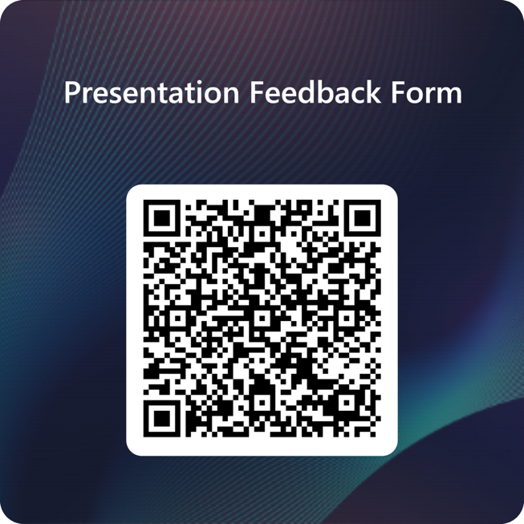
Thank you!
Julie H. Schiavo EdD, MLIS, AHIP
Associate Librarian
Assistant Director, Dental Library
jschia@lsuhsc.edu

