Slide 1

EndNote 25:
Beyond the Basics
Matt Folse, MLIS (He/They)
Scholarly Communications Librarian
& Liaison to the School of Public Health

Slide 2

Objectives
  Download EndNote 25
  Difference from 21 to 25
  EndNote Web
  Find Full Text
  Online Search
  Output Styles
  Sync your library
  Preferences

Slide 3
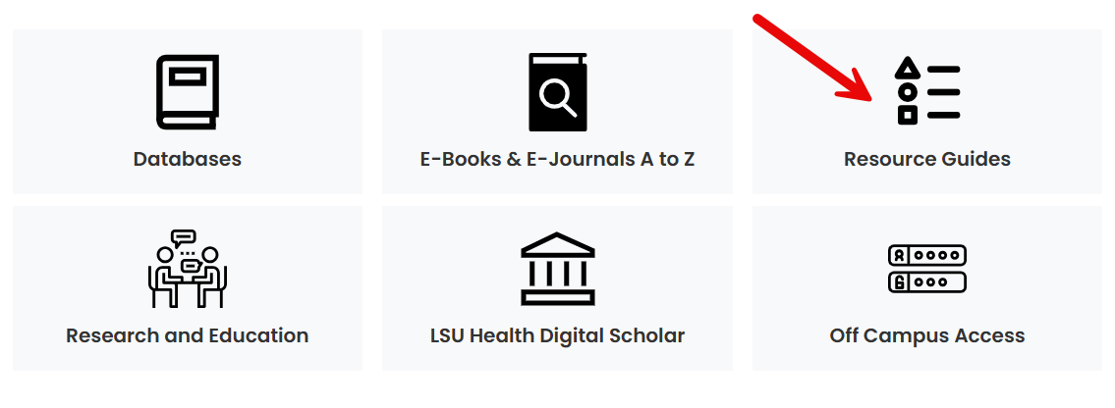
Finding EndNote
  EndNote 25 can be found in the library’s Homepage under Resource Guides

Slide 4
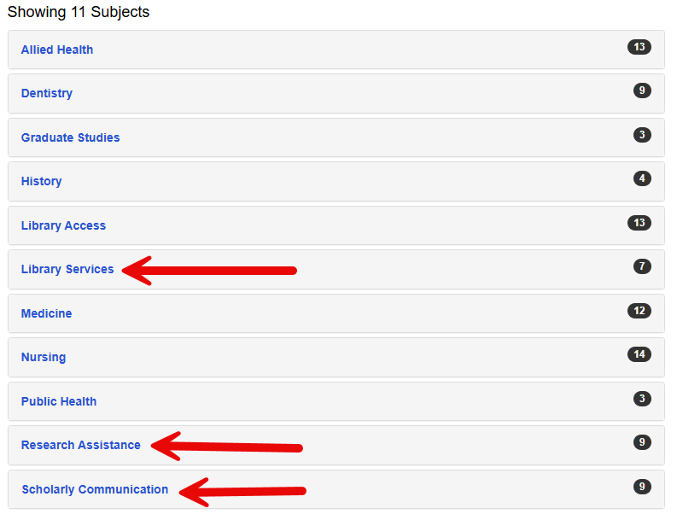
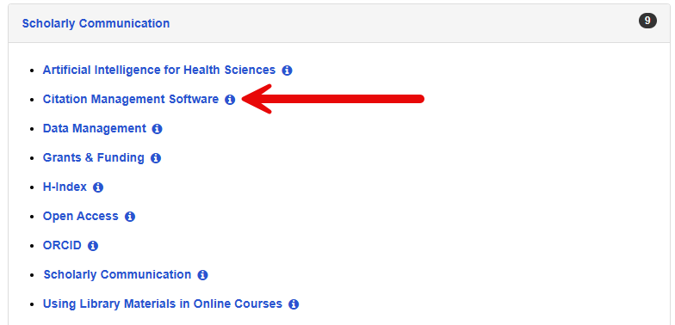
Finding EndNote

Slide 5
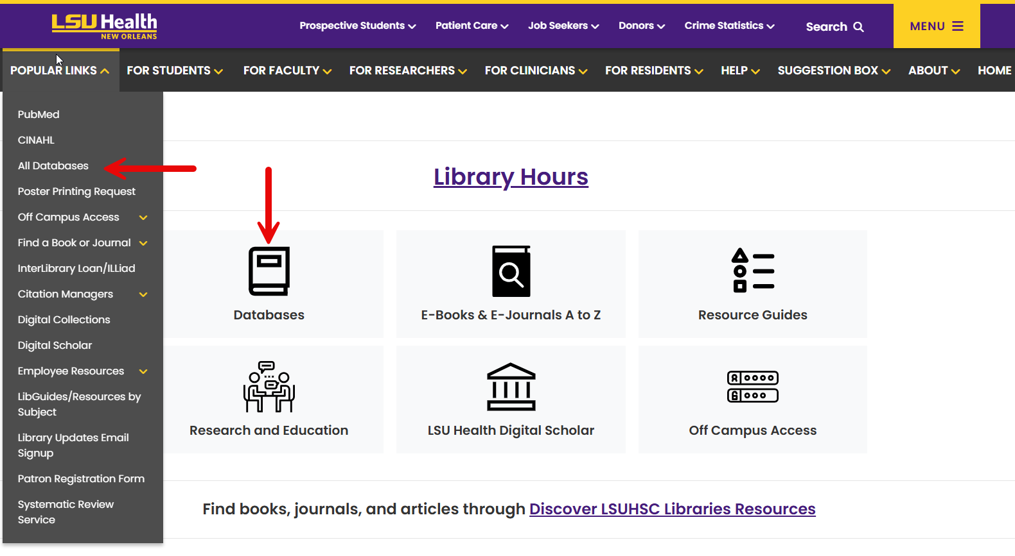
Finding EndNote

Slide 6
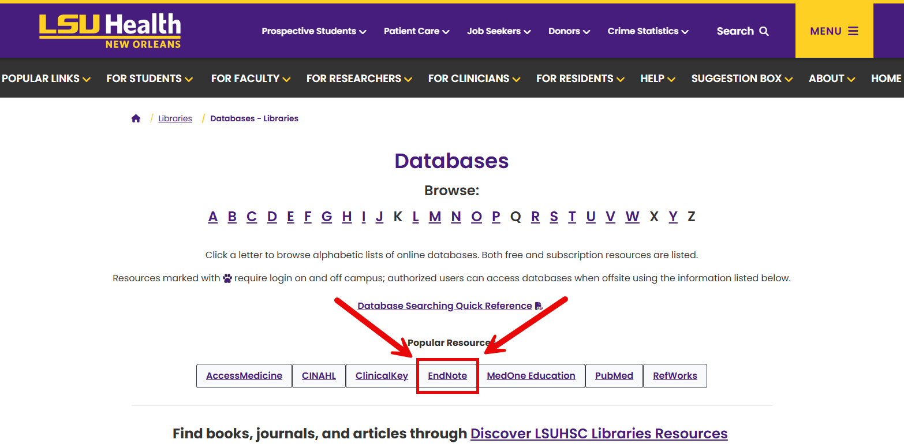
Finding EndNote

Slide 7
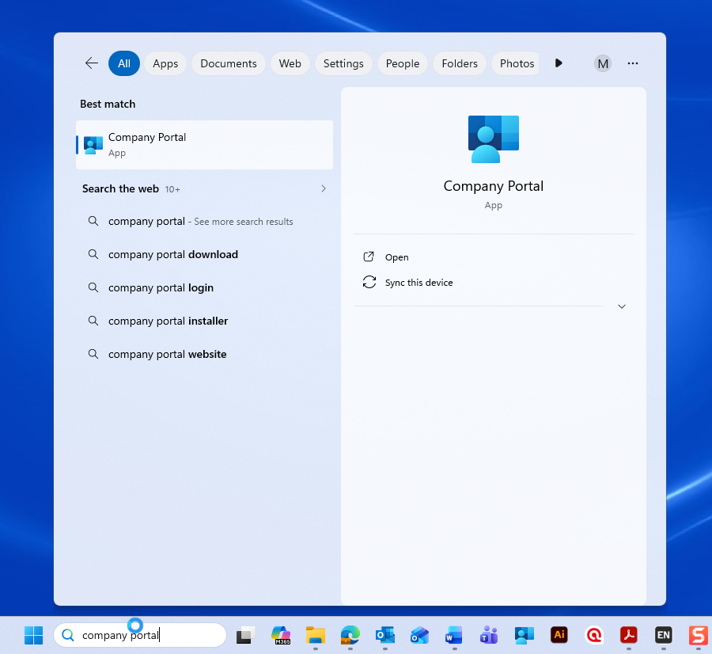
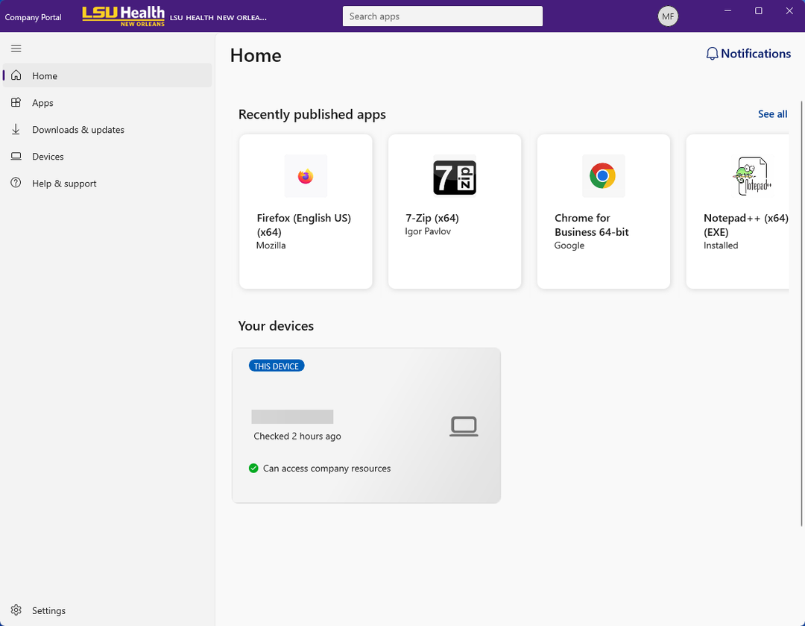
Finding EndNote

Slide 8
EndNote 25 vs. 21
Shared Features
EndNote 25 Features
  Integration with Third Party tools
  Reference Organizing tools
  Collaborating/Sharing
  Cite While You Write
  AI-Powered tools
    ‘Chat’ with pdfs
    Review Key Takeaways and Summaries
    Translate PDFs
    Find a Journal tool
  Cite from PDF

Slide 9
LIVE DEMO

Slide 10
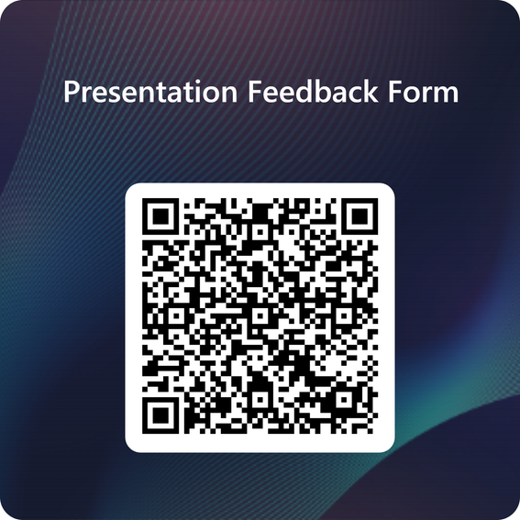

Thank you!
Libraries’ contact:
reference@lsuhsc.edu
or call 504-568-6100
Contact me @:
mfols3@lsuhsc.edu

