Slide 1

DATA PRESERVATION:
The 3-2-1 Rule and More
Elizabeth Holt, MLIS
Digital Initiatives Librarian
November 19, 2025
This presentation will be recorded.

Slide 2
Agenda
What is Data Preservation
Formats, Storage, & Risks
The 3-2-1 Rule
…and More
Conclusion
Resources

Slide 3
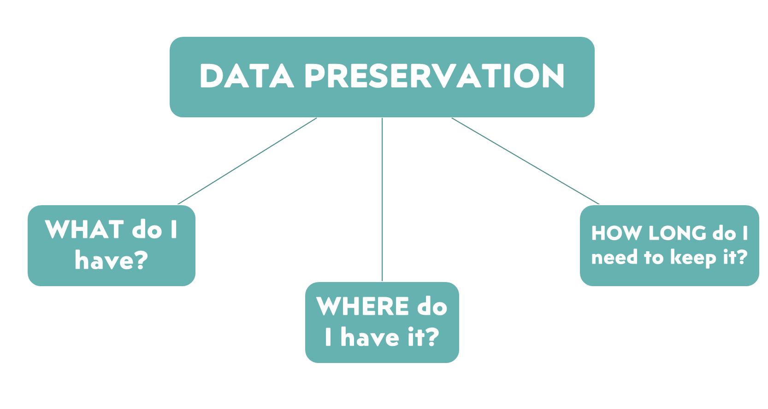
3

Slide 4








Data formats
Analog - Paper, audio cassette, video cassette, etc.
Born digital - .txt, .docx, .jpg, .png, .wma, .mp4, etc.
Digitized - PDF, JPEG, TIFF, CD, DVD, etc.
DATA STORAGE
File cabinet, desk drawer, home office
Computer/laptop hard drive
External hard drive
Network drive
“Cloud” Data center

Slide 5
Risks to data
Obsolesence
  Hardware/Software/Format
  Media/Hardware Failure
  Platform migration
Loss
  Disaster/Power outage
  Data degradation or “Bit rot”
  User error
Threat
  Environment
  Cyberthreats
  Non-compliance

Slide 6
The 3-2-1 Rule
Have 3 copies: One original and two backups.
On at least 2 storage sites:
ex. save one copy on a workstation network and another to an external drive.
Including 1 off-site location:
Keep one file in a different location ex. cloud or physical location.

Slide 7








3-2-1 Rule
=

Slide 8
3-2-1-1-0 Rule
=
Offline

Slide 9




Ndsa levels of digital preservation
  2 copies, each in separate location
  Control access
  Virus check all content
  Create inventory
  3 copies, at least one in a different geographic location
  Create metadata
  Verify properties when moving or copying
  3 copies, at least one in a different disaster threat zone
  Document changes in content, location, format, etc
  Raise metadata standards
  3 copies, at least two in different threat zones
  Plan to address obsolescence and replace corrupted content
  Create a schedule to audit data storage
KNOW
PROTECT
MONITOR
SUSTAIN
Alliance, Digital S. “2019 Levels of Digital Preservation.” OSF, 9 Mar. 2021. Web.

Slide 10
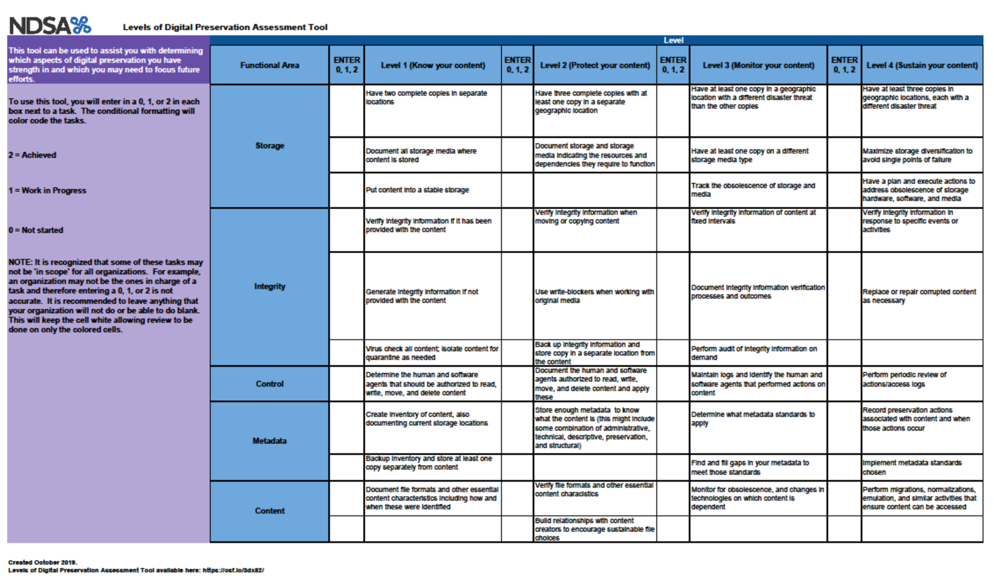
NDSA Digital Preservation Assessment Tool

Slide 11
CONCLUSION
Data Preservation:
Consider what you have, where you have it and how long you’ll
need it when establishing data preservation strategies.
The 3-2-1 Rule:
Create 3 versions = the original + 2 backups
Save files across at least 2 different storage options
Make sure 1 of those storage options is off-site
3a. If it’s very sensitive data, also keep 1 version offline

Slide 12
resources
National Digital Stewardship Alliance Levels of Digital Preservation:
Levels of Digital Preservation
NDSA Digital Preservation Assessment Tool Template:
OSF | AssessmentToolTemplate2019.xlsx
Backblaze.com 3-2-1 vs. 3-2-1-1-0 Backup Strategies:
The 3-2-1 Backup Rule and Beyond: 3-2-1 vs. 3-2-1-1-0 vs. 4-3-2
2025 Southern Mississippi Institutional Repositories Conference (SMIRC)
Workshop: Digital Preservation for IRs
Elizabeth La Beaud, University of Southern Mississippi

Slide 13


Thank you !
Presentation Feedback Form
Libraries Instagram Page
Elizabeth Holt, MLIS
Digital Initiatives Librarian
LSU Health New Orleans Libraries

