Slide 1

Payment Request
Replacing the paper Direct Pay process

Slide 2
Types of Users Involved
Three types of users can access the Payment Request Center:
  Requestors-create payment requests
  Reviewers- review/edit submitted requests (Direct Pay)
  Approvers- approve submitted requests
The Direct Pay office is involved at the level of reviewing,
correcting and auditing transactions prior to payment.

Slide 3
Creating a Payment Request
Creating a Payment Request involves a four-step process of entering and submitting information in a train stop like fashion:
Step #1- Summary Information Page
Step #2- Supplier Information Page
Step #3- Invoice Details Page
Step #4- Review and Submit Page

Slide 4
Workflow- three part process
1. Department requestor enters the payment request in
PeopleSoft
2. The Direct Pay office reviews for completeness, accuracy of data \
entered, compliance with University/State policies
3. Designated department approvers can:
  Approve
  Deny
  Hold
Workflow approval driven by department id on the chartstring
entered.

Slide 5
Approver access
Approvers can access the payment request in four ways:
Via email
Via the PS worklist
Via PS navigation- Main Menu> Accounts Payable> Payments> Payment Request> Payment Request Approval
Via push notifications (see screen shot below)

Slide 6
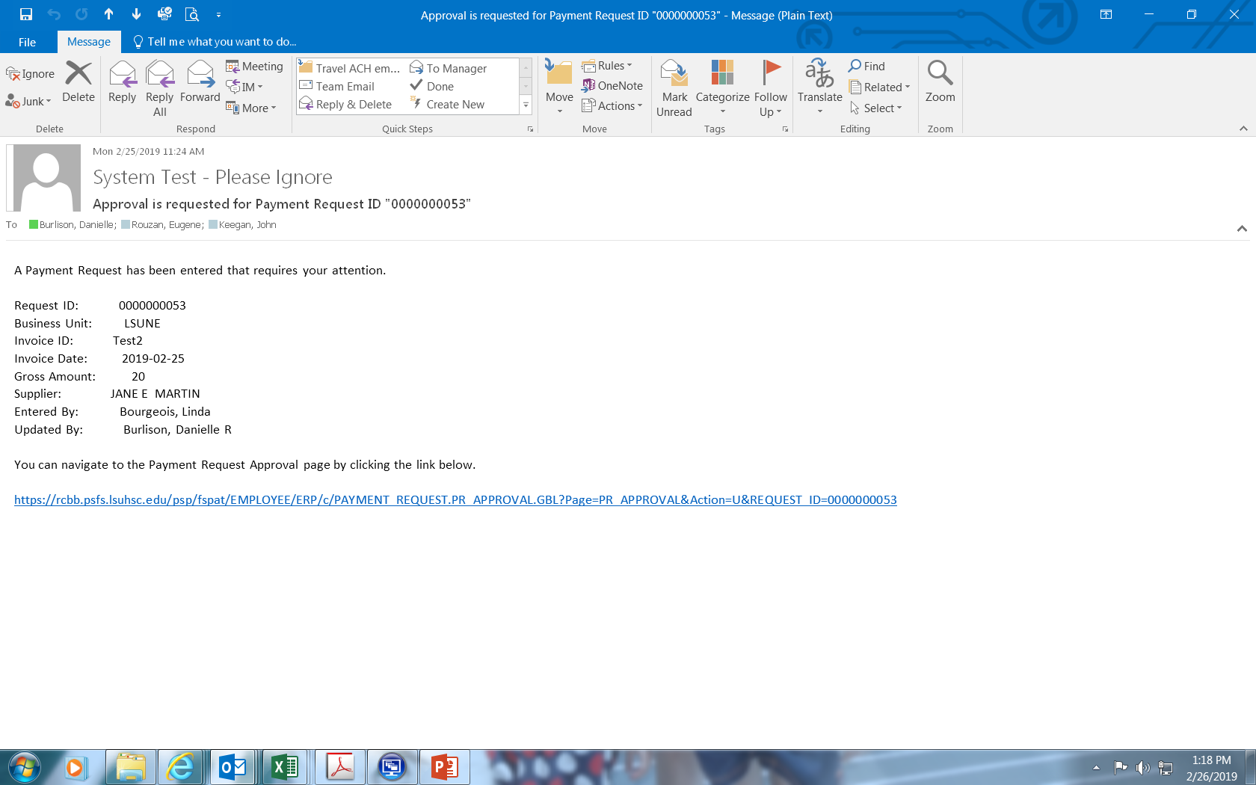

Slide 7
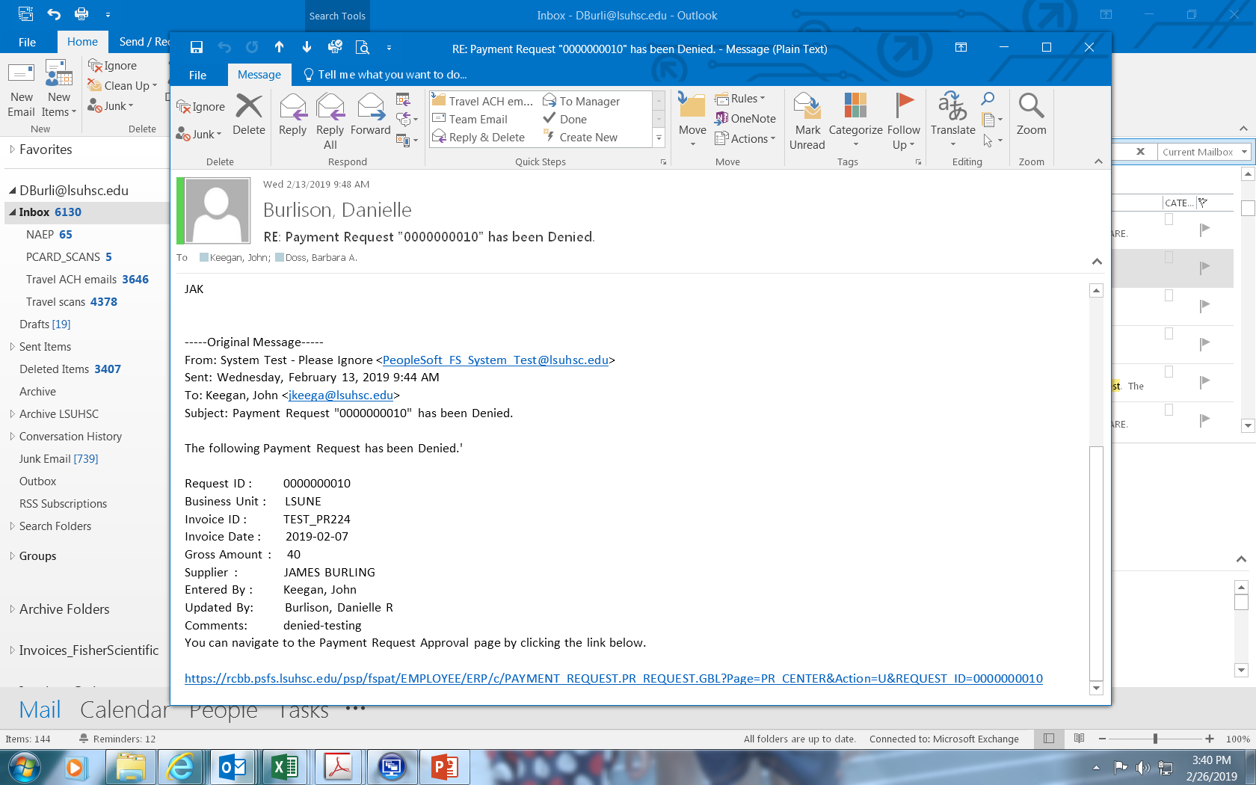

Slide 8
Can approvers edit a Payment Request?
No, Approvers are not able to modify the request. To initiate edits after a Payment Request is submitted, an approver must add comments and then Deny the Payment Request.
If the payment is not approved, the request should be denied and a request to cancel should be detailed in the comments.

Slide 9
Final Steps
Once approved, the voucher build process runs
Vouchers are budget checked
If valid budget, the payment is generated

Slide 10
Status (and their meanings):
New- payment request that has not been submitted by the department (save for later)
Submitted- once the department requestor enters the payment request, it will appear as submitted.
Pending- once reviewed by Direct Pay, the payment will enter into approval workflow and will appear as pending.
Approved- department approval(s) are complete.
Vouchered- once Accounts Payable creates the voucher in PeopleSoft; the voucher id will appear. Scheduled to Pay column will change to “paid” once the paycycle runs.
Denied- payment request denied by department approver. If at any point in time the Payment Request is denied, the requestor gets an email stating why it was denied.

Slide 11
Exclusions
Large volume Direct Pay request- clinical trial payments, summer student stipends via spreadsheet loader
  Contact Direct Pay staff for details
Wires, student refunds, emergency loans
Postage meter replenishment

