Slide 1

EXEMPT DETERMINATIONS AND LIMITED IRB REVIEW
October 4, 2023

Slide 2
Objectives
Remind study teams what does require review by the IRB
Describe the levels of IRB review
Define the categories of Exempt Determinations
Outline the IRB review process and limited IRB review

Slide 3
REFRESHER:
Does the Study Require IRB Review?
If the study meets both of the following definitions, then it requires IRB review:
Is it Research?
A systematic investigation, including development, testing, and evaluation, designed to develop or contribute to generalizable knowledge (HHS Common Rule)
Any experiment that involves a test article and one or more human subjects, and that either must meet the requirements for prior submission to the Food and Drug Administration (FDA)
Does it involve Human Subjects?
A living individual about whom an investigator conducting research:
  Obtains information or biospecimens through intervention or interaction with the individual, AND uses, studies, or analyzes the information or biospecimens; OR
  Obtains, uses, studies, analyzes, or generates identifiable private information or identifiable biospecimens (HHS Common Rule)
An individual who is or becomes a participant in research, either as a recipient of the test article or as a control. A subject may be either a healthy individual or a patient (FDA)
Notes:
As previously discussed, the definitions vary between Common Rule and FDA regulations
Systematic Investigation: activity that involves a prospective plan that incorporates data collection, either quantitative or qualitative, and data analysis to answer a question or hypothesis
Generalizable Knowledge: Knowledge from which conclusions will be drawn that can be applied to populations outside of the specific study population and contributes to a body of knowledge.
INTERVENTION: includes physical procedures by which information or biospecimens are gathered and manipulations of the participant or participant’s environment that are performed for research purposes.
INTERACTION: communication or interpersonal contact between investigator and participant.
IDENTIFIABLE PRIVATE INFORMATION: is private information must be individually identifiable for which the identity of the participant is or may readily be ascertained by the investigator or associated with the information.

Slide 4
Levels of IRB Review
There are three levels of IRB review for human participant research. Each category is different in the level of scrutiny and review procedures required.
Exempt
Exempt from the requirements of Common Rule but not exempt from ethical considerations
Fits one or more of the 8 Exempt Review Categories
Expedited
Research involving minimal risk*
Fits one or more of the 9 Expedited Review Categories
Full Board
Greater than minimal risk to subjects
Not covered under other review categories
Limited IRB Review may apply
Does not mean “fast”
Reviewed by fully convened Board
*Minimal Risk: The probability and magnitude of harm or discomfort anticipated in the research are not greater than those ordinarily encountered in daily life or during the performance of routine physical or psychological examinations or tests
Notes:
Exempt research is a specific sub-set of “research involving human subjects” that does not require ongoing IRB oversight. Research can qualify for an exemption if it is no more than minimal risk and all of the research procedures fit within one or more of the exemption categories defined by federal regulations. Studies that qualify for exemption must be submitted to the IRB for review before initiation of the research. Pursuant to LSUHSC-NO policy, investigators do not make their own determination as to whether a research study qualifies for an exemption - the IRB issues exemption determinations.

Slide 5




Exempt Categories
Category 1: Research conducted in established or commonly accepted educational settings, involving normal educational practices, so long as the research is not likely to adversely affect students’ opportunity to learn the required educational content or the assessment of educators who provide instruction. May require information sheet *Cannot include any other procedures, such as collection of clinical data or biospecimens | Category 2: Use of educational tests, surveys, interviews, or observations of public behavior May require information sheet *Limited IRB Review may be required. NO CHILDREN. | Category 3: Research involving benign “behavioral” interventions in conjunction with the collection of information from an adult subject through verbal or written responses (including data entry) or audiovisual recording if the subject prospectively agrees to the intervention and information collection (e.g., playing games, providing education to change behavior, puzzles, etc.) May require information sheet *Limited IRB Review may be required. NO CHILDREN. NO DECEPTION. | Category 4: Secondary research using identifiable information or biospecimens if publicly available, or recorded such that subjects cannot be re-identified* *See §346.104(d)(4)(ii), (iii), and (iv) for all criteria

Slide 6



Exempt Categories
Category 5: Public service program research or demonstration projects May require information sheet | Category 6: Taste and food quality evaluations May require information sheet *Only exempt category that FDA allows | Category 7: Storage or maintenance of identifiable information or biospecimens for secondary use. *Broad consent and limited IRB review required. **Most institutions do not use this category | Category 8: Secondary research using identifiable information or biospecimens. *Broad consent and limited IRB review required. **Most institutions do not use this category
Notes:
If all study activities do not fall into one or more of these categories, then the application type should be upgraded to expedited or full board.

Slide 7
Informed Consent for Exempt Studies
Voluntary informed consent should be obtained from participants for any exempt research where the investigator will be collecting data through interaction with participants.
For Exempt research, LSUHSC requires investigators to provide an Information Sheet to participants or read from an oral script.
The information sheet or script should:
  Provide a brief description of the research
  Include the basic elements of informed consent
  Not contain a signature block
BELMONT REPORT
Beneficence
Justice
Respect for Persons
Notes:
As a refresher, the Belmont Report summarizes the three basic ethical principles for protection of Human Subjects. The ethical principle of respect for persons means individual should be treated as autonomous agents, and this is put into action by requiring some level of informed consent when interaction with subjects is involved in the study design.

Slide 8
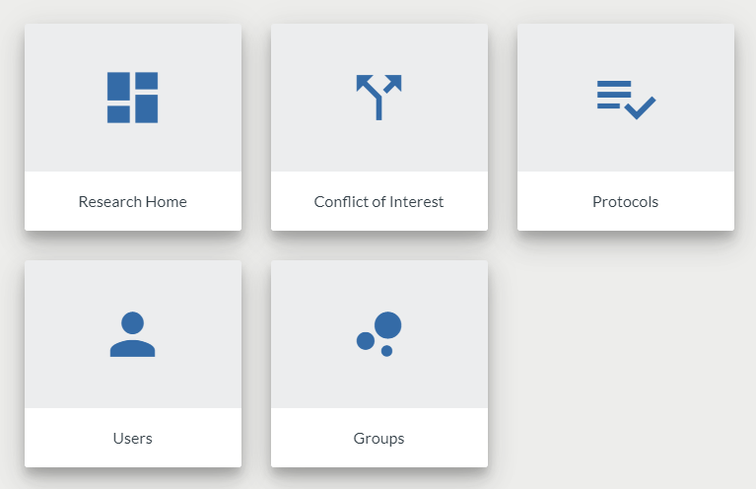
How to Submit for an Exempt Determination
Start a New Protocol in Kuali Protocols and select Exempt Research under “Protocol Type.”
Additional instructions for submitting a study for exempt determination are available in the Kuali Quick Guides found on the IRB website.

Slide 9
IRB Review Process
Initiation of IRB Application via Kuali
Submission of the Application to the IRB
Review of the Application by IRB Analyst
*Limited IRB Review
If Changes Needed, Application Returned to Study Team until Finalized
Study May Begin
Designated IRB Reviewer Issues Approval
Notes:
PI or study team member creates an application in Kuali
PI submits the application to the IRB
The designated reviewer completes a full review for exempt, expedited or reliance applications; or an administrative review for full board studies.
If changes are needed, the administrative reviewer will return the application to the study team member until issues are resolved.
If no issues were identified or once all issues are resolved, the IRB will approve the study. The study team will receive an email from the Kuali System with the IRB determination

Slide 10
Limited IRB Review
What is it?
Ensures that there are adequate provisions to protect the privacy of participants and to maintain the confidentiality of the data
When does it apply?
For exempt studies where there is still a requirement to address privacy and confidentiality, such as Category 2(iii) and 3(i)(c)
IRB Chair or experienced reviewer designated by the Chair from among IRB members
Who conducts it?

Slide 11


Slide 12
Save the Date!
November Lunch & Learn
Date: November 1, 2023
Time: 12:00 PM
Topic: Expedited Review

