Slide 1
Everyone Wants to Zoom!

Slide 2
What is Zoom and How Is It Different from What I Have Used Before?

Slide 3
Zoom is Webconferencing: Audio and Video communication across the Internet.
It is similar to Facetime, Webex, and Skype
It is also similar to Videoconferencing, but with some significant differences.

Slide 4
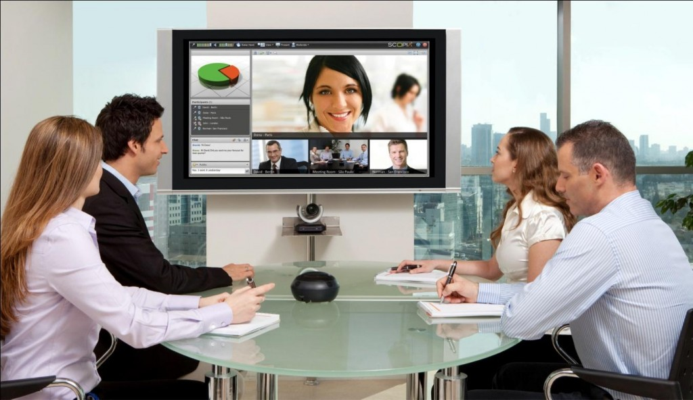
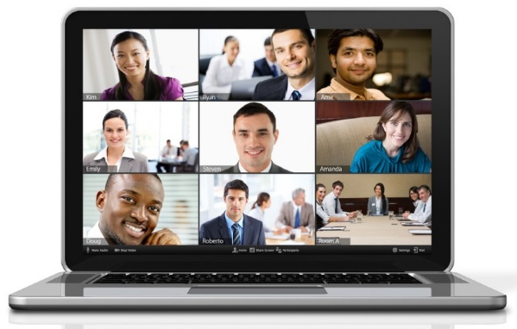
Videoconferencing:
Hardware endpoint
Room based
Requires dedicated infrastructure
Webconferencing:
Software endpoint
Mobile based
Uses existing infrastructure

Slide 5
Who Can Zoom?
Everybody!
But only these folks can Host a Zoom Meeting:
LSUHSC Faculty
LSUHSC Staff
LSUHSC Students

Slide 6
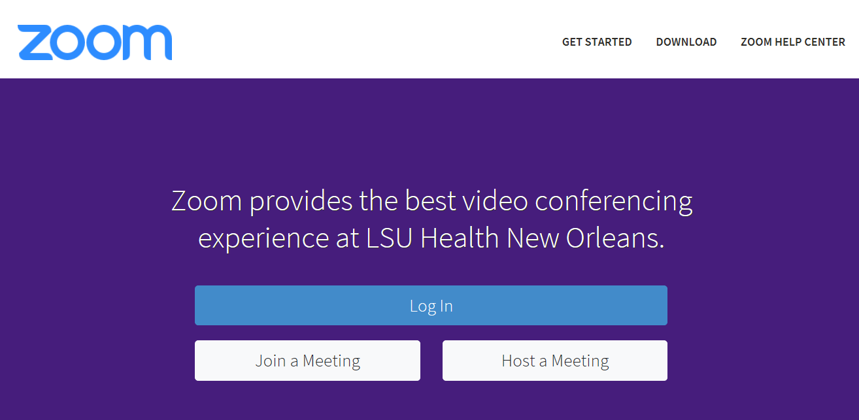
lsuhsc.zoom.us

Slide 7
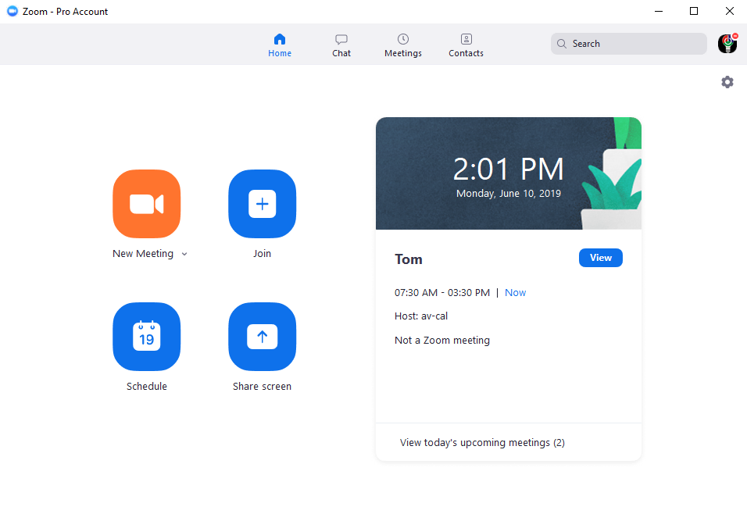
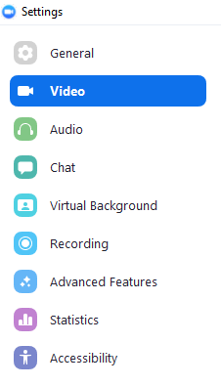

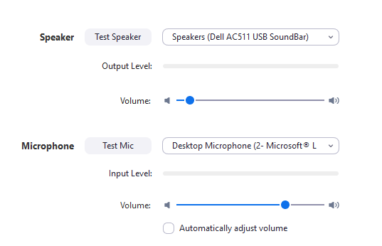

Slide 8
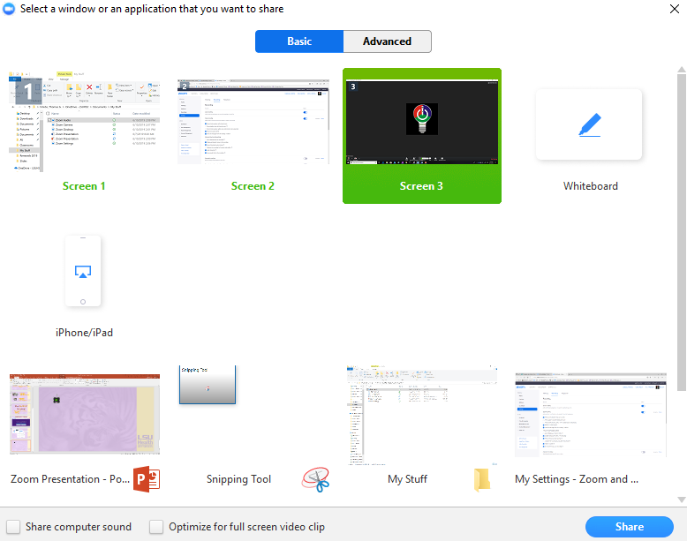


Slide 9
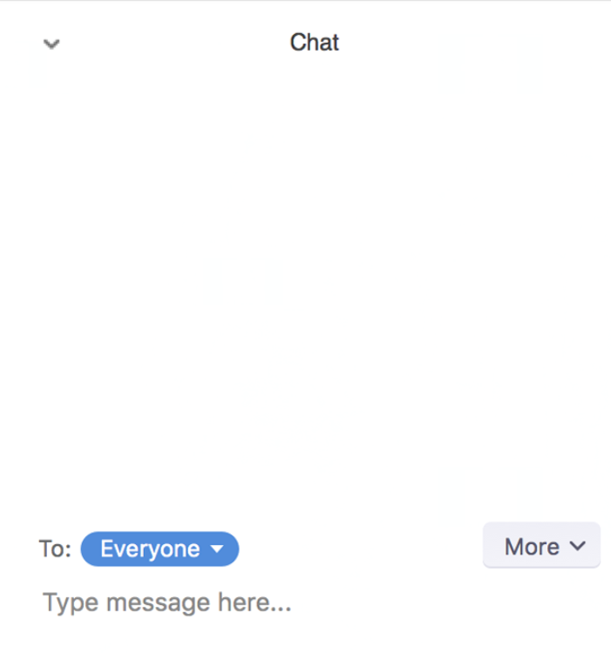
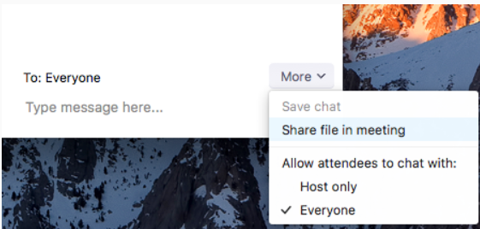

Slide 10
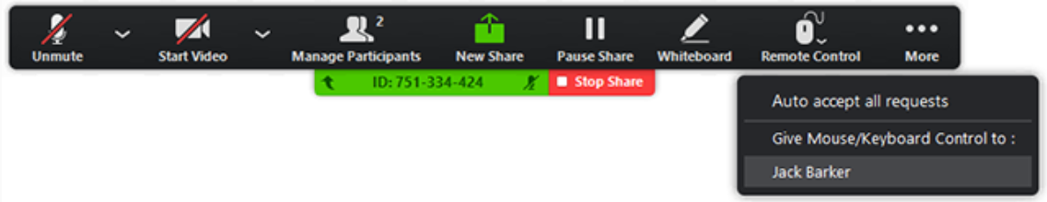

What Else Can I Do?

Slide 11
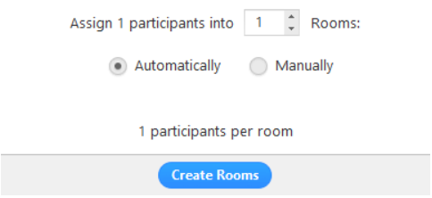

Slide 12
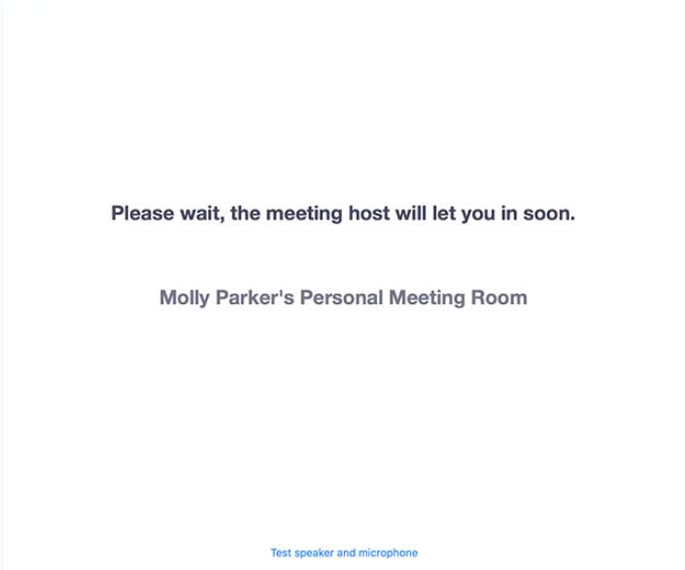
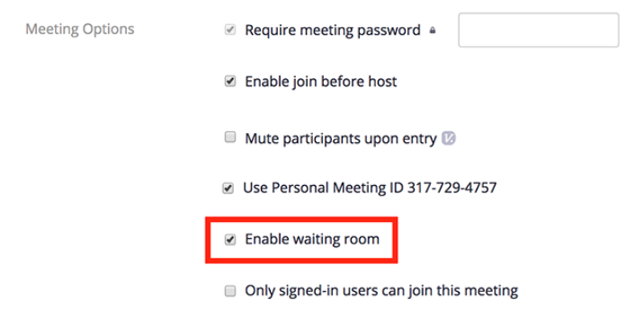

Slide 13
Encryption
“End-to-end encryption is an added layer of application security. Zoom can encrypt all presentation content at the application layer using TLS 1.2 with Advanced Encryption Standard (AES) 256-bit algorithm.”
“End-to-end encryption is also designed to facilitate HIPAA based compliance requirements.”

Slide 14
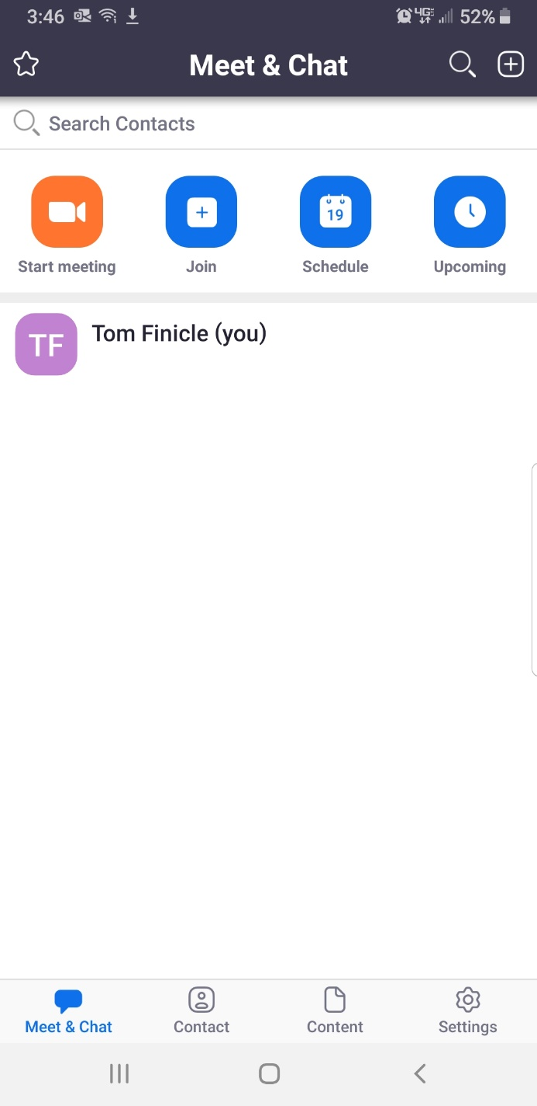
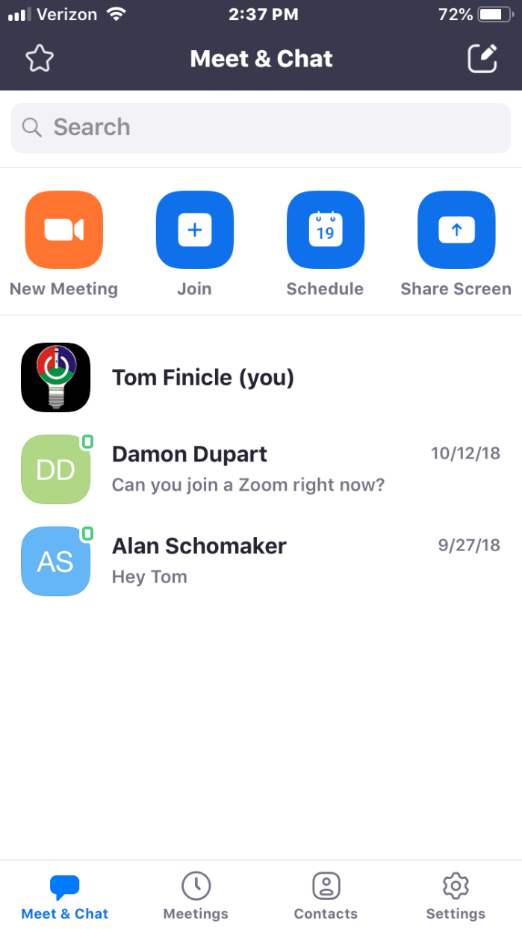

Slide 15
What Do I Need To Zoom?
A Device with a Microphone, Speaker, and Camera:
Computer
  PC or Mac
  Desktop or Laptop
Tablet
Smartphone

Slide 16
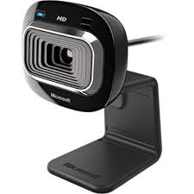
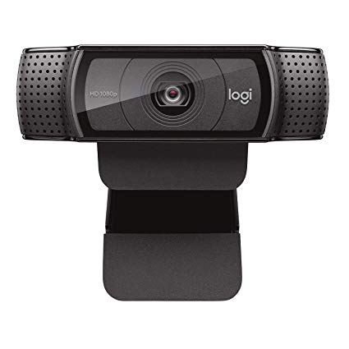
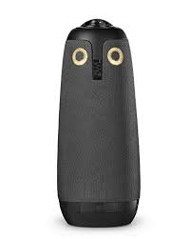

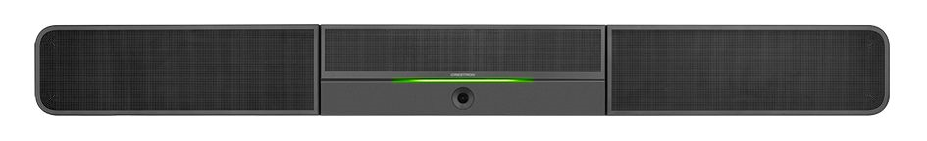
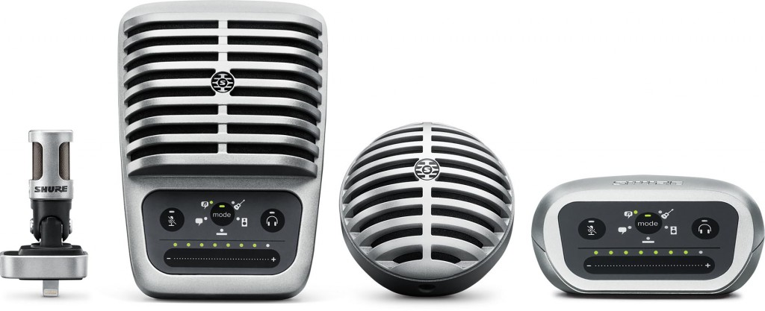

Accessories for Computers

Slide 17
Questions?
lsuhsc.zoom.us
enterpriseavgroup@lsuhsc.edu

