Slide 1
Explore Functions in Excel
September 17, 2019

Slide 2
What is a function?
A function is a previously defined formula which performs calculations using specific values in a particular order
Examples: Sum, Average, If, Match
Notes:
So I have a textbook definition which you can read on the slide, but personally I like to think of functions like a drink vending machine. You put in some money and then a drink choice as inputs, and then you get your drink and the appropriate change as output.

Slide 3
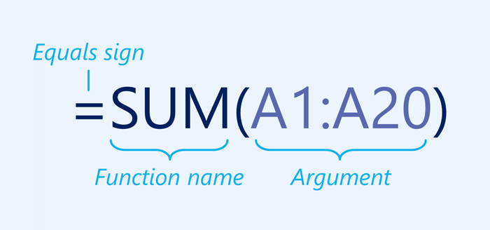
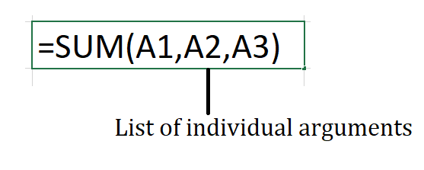
Parts of a function
Notes:
A function must be written a specific way, which is called the syntax. The basic syntax for a function is the equals sign (=), the function name (SUM, for example), and one or more arguments. Arguments contain the information you want to calculate. The function in the example below would add the values of the cell range A1:A20.

Slide 4
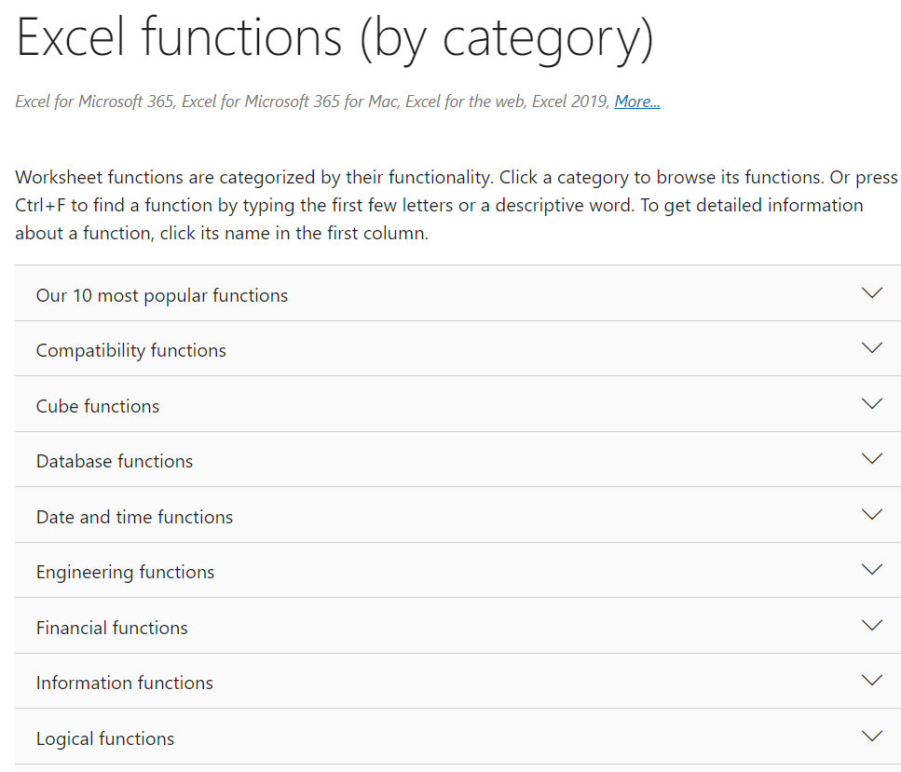
List of Functions
How do you know which functions exist or which to use?
https://support.microsoft.com/en-us/office/excel-functions-by-category-5f91f4e9-7b42-46d2-9bd1-63f26a86c0eb
Notes:
Microsoft has very good documentation on the internet. This allows for easily searchable functions. This powerpoint and the appropriate link will be posted on the IT Office hours web page. Shift f5 to resume from a specific page

Slide 5
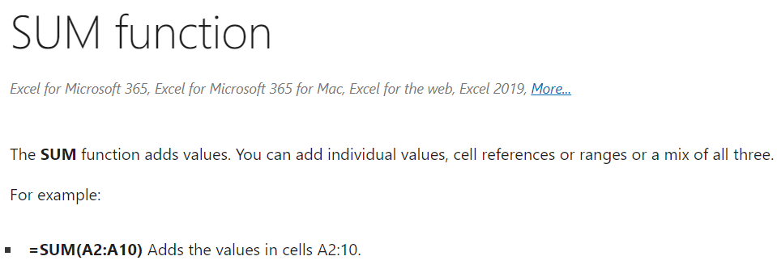
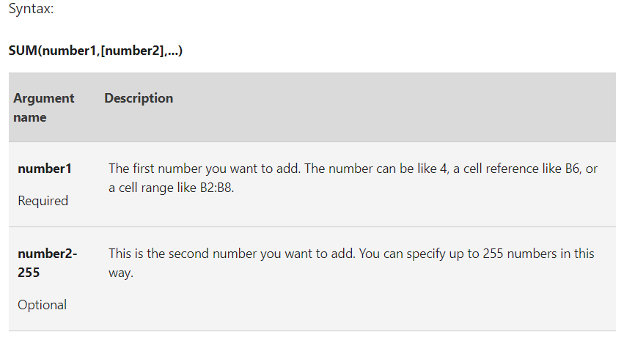
Function Documentation
Notes:
Microsoft has very good documentation. So here is the Sum function example. The first part just explains what the function does. The later part talks about the specific syntax. I’d like to point out that it requires numbers to sum up and there is a cap of 255 inputs.

Slide 6

Nested Functions
Is it possible to use a function inside of another function?
YES!
https://support.microsoft.com/en-us/office/use-nested-functions-in-a-formula-9d7c966d-6030-4cd6-a052-478d7d844166
Notes:
Yes,

Slide 7
Non-Native Functions
What if the function I need doesn’t exist?
Solution 1: Add-in functions
https://support.microsoft.com/en-us/office/user-defined-functions-that-are-installed-with-add-ins-reference-729ca23f-e362-4d51-9401-a9060011eb9b
Solution 2: Visual Basic for Applications
Notes:
Yes,

Slide 8
Live Demo
Notes:
Yes,

