Slide 1

IT Office hours – 1
Data Sharing 101
April 25, 2019

Slide 2

Data Sharing 101
We have many tools and services that can be used to store and share data safely.
When evaluating how to store data ask these questions:
  What am I storing?
  Who do I want to share it with?
  How will others access it?

Slide 3
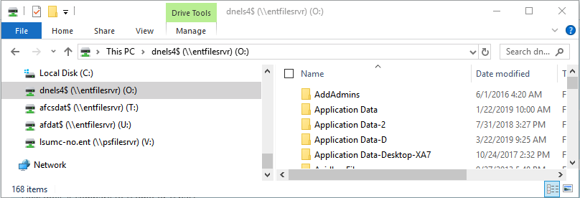
Network Drives
I want to store files related to work that my colleagues would have access to
  Protected behind the firewall
  Stored on LSUHSC servers
  Backed up nightly
More Information
  Accessible via Windows Explorer
  Protected behind the firewall
  Managed by IT Server Group and Support Groups
  Your IT Supporters can give you a breakdown of what drives you have access to and how they should be used.
  If you need a file restored – files are backed up nightly – you can reach out to your IT supporter

Slide 4
LSU Health Files
More Information
  Documentation: https://lsuh.sc/filesdocs
  Accessible on and off the LSUHSC network
  Ability to restrict access to specified recipients
  Ability to terminate file access after file download
  Files remain available for a max of 14 days
  There is an Outlook plugin for quick and easy access without leaving Outlook
  Web interface has more features and provides access when you are away from your computer
    https://files.lsuhsc.edu
  Administration and support provided by the Postmaster team
I want to
  Send a file larger than 25 MB to an internal user
  Send a file securely to an external user
  Request large or zipped file from an external user

Slide 5

Dell Data Protection
More Information
  Documentation: https://lsuh.sc/ddpdocs
  Devices that have Dell Data Protection installed will require devices such as USB drives to be encrypted if they are written to.
  When USB is encrypted you will be prompted to set a password that you will need to remember to access data on when using an external machine
  If the password is lost or forgotten IT supporters and Help Desk can assist in resetting password
  Supported on PC and Mac
  Support provided by the IT Support groups and Help Desk
I want to
  Transfer a file physically via a USB drive or External Hard Drive
  Take a presentation on a USB drive to give a presentation at an external institution

Slide 6

Office 365 OnEDrive
More Information
  Documentation: https://lsuh.sc/onedrivedocs
  Sharing with only other LSUHSC users supported
  Works with PC/Mac, iOS, and Android devices
  Review and restore older versions of files
  Deleted documents are recoverable for 90 days
  5 TB of storage per user
  Support provided by the Webmaster team
I want to
  Store work files that I can easily access and work on from mobile devices on and off the LSUHSC network
  Share and collaborate on work files with internal colleagues
  Access and restore older versions of a file

Slide 7

Office 365 SharePoint Team Site
More Information
  Documentation: https://lsuh.sc/spodocs
  Sharing with Internal and External LSUHSC users supported
    Send request for a SharePoint site to Webmaster
    Information needed found in link above
  External users can use their institutions credentials to access data
  Works with PC/Mac, iOS, and Android devices
  Review and restore older versions of file
  Deleted documents are recoverable for 90 days
  Support provided by the Webmaster team
I want to
  Share and collaborate on work files with internal and external colleagues
  Store and collaborate on work files that I can easily access and work on from mobile devices on and off the LSUHSC network
  Access and restore older versions of a file

Slide 8

Globus
I want to
Transfer large volumes of research data internally or externally
Easily and securely share research data with the people who need it—without creating temporary accounts or transferring data to an external storage system
Improve security by avoiding duplication of data on cloud storage
More Information
https://www.globus.org/
Pilot implementation in progress at LSUHSC-NO
Email globus@lsuhsc.edu for more information

Slide 9
FTP / FTPS / SFTP File Transfers
More Information
  Documentation: https://lsuh.sc/ftpdocs
  To have an FTP service configured– send a request to webmaster including information requested on the page linked to above
  Order of Preference
    FTPS = Secure and free. Accessible from outside the LSUHC
    SFTP = Secure with a cost shared between area
    FTP = Less secure and free
  Support provided by the Webmaster team
I want to
  Schedule a process to routinely transfer files to an external user or vendor on a weekly basis
  Schedule a process to have an external user or vendor transfer a file to a network location on a weekly basis
  Transfer a large file with a vendor or research partner that only supports FTP, FTPS, or SFTP

Slide 10

Thank You!

Slide 11
IT Office Hours - More Information
More information:
  https://lsuh.sc/itofficehours/
    Information on future sessions
    Link to access session remotely (Zoom)
    Links to presentation files
    Sign up for the listserv mailing list
  Survey on what you'd like to see as far as future topics

